Slide 1
YOLOv4: Optimal Speed and Accuracy of Object Detection
Alexey Bochkovskiy¹ Chien-Yao Wang² Hong-Yuan Mark Liao²
alexeyb84@gmail.com¹, Institute of Information Science Academia Sinica, Taiwan²
In arXiv, Vol. 2004.10934, 2020
Reporter: Le Phong Phu V1
玄承浩 V2
王澤文 V3
張議隆 V4
Advisor: Jenn-Jier James Lien (連震杰).
Robotics Lab, CSIE NCKU.
Edit date : 2023/08/28

Slide 2
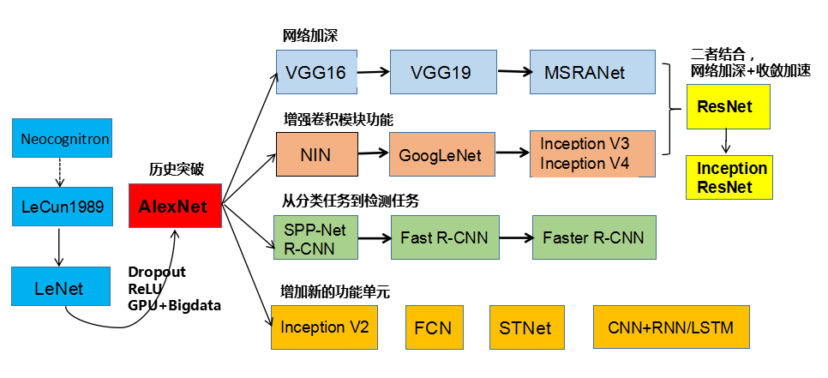
J: 這些模型都可以用GPT(Generative Pre-Training) 和 Transformer 但只用Transformer效果不好，用 CNN+ Transformer效果較好
0.1 Deep Learning: History
Which one do I want to be?
Basic CNN Creation
Modified CNN
CNN Application: Data collection, organization and analysis / benchmark
DenseNet
CVPR2017
1. Backbone CNN: Backbone encoder for feature extraction and classification
ResNeXt
CVPR2017, Fair
Getting Deeper: Very Deep CNN - 13+3 or 16+3 Layers
➔ 5 blocks (downsampling) + 3 FC
Squeeze-and-Excitation
= channel weight
SE
Net
Cvpr2018,
Hu, Shen, Albanie, Sun, Wu
Deep CNN:
5 Convolution Layers (Feature Extraction) +
3 Full Connection Layers (NN, Classification)
ICLR2015, U. Oxford, Zisserman
Residual
=skip connection
Input image size can be flexible
Inception architecture:
CVPR2016, MSR
CVPR2015, Google
2. Multi-Task: Detection (ROI) + Classification
ICLR 2016
tPami1989, LeCun
NIPS2012, U Toronto, Krizhevsky & Hinton
ECCV2014, MSR, He, Zhang, Ren, Sun
Upsampling + Pixelwise
Mask R-CNN
CVPR2014, tPami2015 MSR, Girshick & Berkeley
ICCV2015, MSR, Grishick
NIPS2015, MSR,
Ren, He, Grishick, Sun
ICCV2017, FAIR,
He, Gkioxari, Dollar, Grishick,
3. Temporal Domain
UNet
IEEE1998, LeCun
Input image size can be flexible
CNN (LeNet-5):
2 Convolution Layers (Feature Extraction) +
3 Full Connection Layers (NN, Classification)
recurrent
TCN
Fully Convolutional Networks
ICRA2017, Google, Berkeley, Finn, Levine
Temporal
Convolutional
Network, arXiv2018
tPAMI: IEEE Transactions on Pattern Analysis and Machine Intelligence
CVPR: Conference on Computer Vision and Pattern Recognition
ICCV: International Conference on Computer Vision
NIPS: Conference on Neural Information Processing Systems
ICLR: International Conference on Learning Representation
NIN: Network in Network
R-CNN: Region-based Convolutional Network method
SPP-Net: Spatial Pyramid Pooling networks
4. GAN, InfoGan, AutoEncoder:
Yolo V1 V2
YoloV3
Generative Adversarial Network Vs. PCA
arXiv2018
Redmon, Farhadi
Yolo
V4
5. Reinforcement Learning
arXiv2020
Bochkovskiy, Wang, Liao
Unsupervised
Focal Loss
Retina
ICCV2017, Fair,
Lin, Goyal, Girshick, He, Dollar

Slide 3
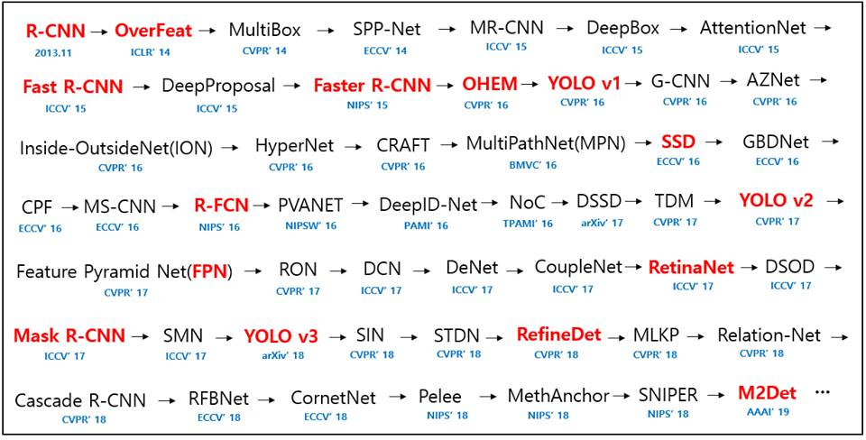
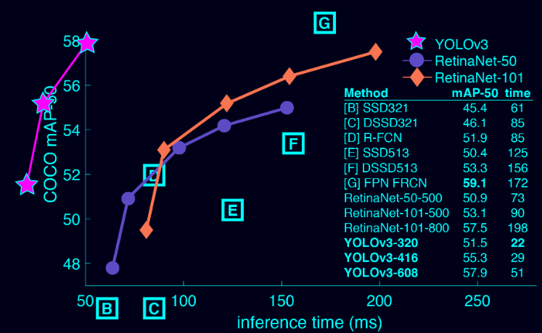
0.2 Deep Learning: History of Object Detection Methods (up to 2019)
Fig. Results of different detection methods on COCO dataset
https://paperswithcode.com/sota/object-detection-on-coco

Slide 4
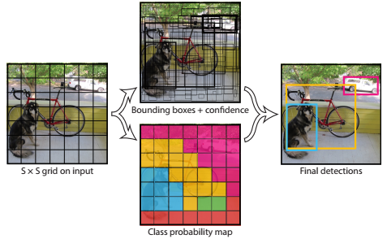
YoloV1 and YoloV2:
Box 1: b_{x}, b_{y}, b_{w}, b_{h}, c - 5 parameters
Box 2: b_{x}, b_{y}, b_{w}, b_{h}, c - 5 Parameters
* Confident value: c = Pr(Object)*IoU
~c= Pr(~Obj)
Pr(Class_i|Obj): Classes C=20 ➔ pc₀, pc₂, …, pc₁₉
0.2 Yolo Principle ??
YOLO splits the input image into SxS grid and for each grid, generates n bounding boxes, confident values and class probabilities for those bounding boxes.
Note that bounding box is more likely to be larger than the grid itself.
3. Multi-Subnets: Detection Part –
Bbox Regression (continue) Subnet and Classification (discrete) Subnet
Fg/Bg
Fig. Grid Cell prediction in YOLOv1
3. Multi-Subnets: Detection Part –
Bbox Regression (continue) Subnet and Classification (discrete) Subnet
(Fg/bg)
Posterior prob.
C: Total number of classes
K anchors
NMS: Non-Maximum Suppression
Fig. Grid Cell prediction in DC-SPP-YOLO

Slide 5
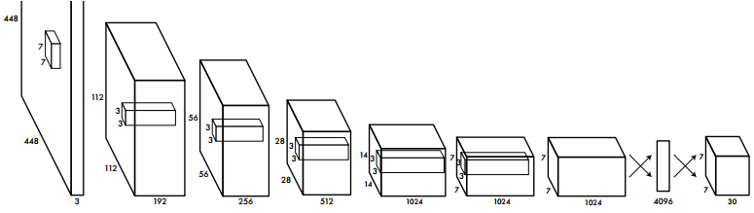
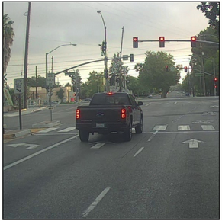
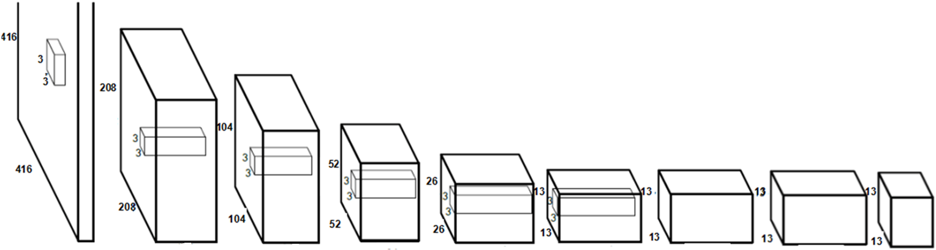
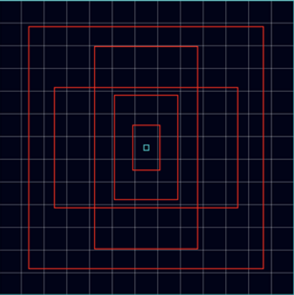
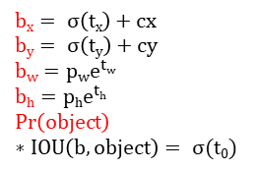
0. YoloV1 and YoloV2
Box 1: b_{x}, b_{y}, b_{w}, b_{h}, c.
Box 2: b_{x}, b_{y}, b_{w}, b_{h}, c.
Cell_{Cls}: pc₀, …, pc₁₉ (PASCAL VOC)
1. YoloV1
2. YoloV2
Backbone: Custom Network
24 Convolutional layers
4 Max-pooling layers.
2 Fully connected layers.
7x7 grid cells,
each cell(1 Cell)
- Total: 7x7x2 = 98 BBoxes.
- For each o/p vector:
30ch = (4+1)(b1) + (4+1)(b2) + 20(class)
Tommy
For each grid, select one from two boxes by having max c
Later, we use NMS, but for each box has only one object.
Input Image
WxH: 448x448 pixels
Tommy
Conv. Layer
7x7x64-s-2
Max-pool Layer
2x2-s-2
Conv. Layer
3x3x192
Max-pool Layer
2x2-s-2
Conv. Layer
1x1x128
3x3x256
1x1x256
3x3x512
Max-pool Layer
2x2-s-2
Conv. Layer
1x1x256
3x3x512
1x1x512
3x3x1024
Max-pool Layer
2x2-s-2
Conv. Layer
1x1x512
3x3x1024
3x3x1024
3x3x1024-s-2
Conv. Layer
3x3x1024
3x3x1024
Conn. Layer
Conn. Layer
S:stride
S-2 : stride 2
x4
x2
Tommy
30channels detail Information
= (Box1 Info(x,y,w,h)[4]+confidence[1]) + (Box2 Info(x,y,w,h)[4]+confidence[1])
Conditional class probability of entire classes[20]
Prediction S x S X (B*5 + C), (S:grid counts, B:Bbox counts, C:Class probabitly)
b_{x}, b_{y}, b_{w}, b_{h}, c: Geometric Infor (Image coordinate)
pc₁, pc₂, …, pc₂₀: Prob of Object belong to each class
(1) Batch Normalization (after every Convolutional Layer)
(PASCAL VOC)
Backbone: DarkNet-19 ??
21 Convolutional layers
4 Max-pooling layers.
(2) Higher resolution final feature map (13x13x125c)
(3) Fully Convolutional Network
Box 1: t_{x}, t_{y}, t_{w}, t_{h}, t_{O}, pc₀, …, pc₁₉
Box 2: t_{x}, t_{y}, t_{w}, t_{h}, t_{O}, pc₀, …, pc₁₉
…
Box 5: t_{x}, t_{y}, t_{w}, t_{h}, t_{O}, pc₀, …, pc₁₉
13x13 cells, each cell = grid
Path-through
- Total: 13x13x5 = 845 BBoxes.
Tommy
7x7 -> 12 x 12
Turn 26x26x512 to 13x13x2048
-For each o/p vector
125c = 5x(5+20)
(Skip after than concatenate)
Tommy
Input Image
WxH: 416x416 pixels
(6) Fine-grained feature detector.
Later, we use NMS, for each cell, can contain 5 objects
(5) Location prediction
$$bx= σ\left(tx\right)+cx$$
$$by= σ\left(ty\right)+cy$$
$$bw=p{we}^{tw}$$
$$bh=p{he}^{th}$$
$$\operatorname{Pr}\left(object\right)∗IOU\left(b,object\right)= σ(t0)$$
3
32 - 64
64 - 128
128 - 256
256 - 512
512 - 1024
512 - 1024
1024
125
Conv. Layer
3x3x32-s-2
Max-pool Layer
2x2-s-2
Conv. Layer
3x3x64
Max-pool Layer
2x2-s-2
Conv. Layer
3x3x128
1x1x64
3x3x128
Max-pool Layer
2x2-s-2
Conv. Layer
3x3x256
1x1x128
3x3x256
Max-pool Layer
2x2-s-2
Conv. Layer
3x3x512
1x1x256
3x3x512
1x1x256
3x3x512
3x3x1024-s-2
Conv. Layer
1x1x512
3x3x1024
1x1x512
3x3x1024
Conv. Layer
3x3x1024
3x3x1024
3x3x1024
Conv. Layer
1x1x125
t_{x}, t_{y}, t_{w}, t_{h}, t_{O} : Geometric Inform (Cell coordinate)
b_{x}, b_{y}, b_{w}, b_{h}, c: Geometric Inform (Image coordinate)
pc₁, pc₂, …, pc₂₀: Prob of Object belong to each Class
(4) Anchor boxes + Dimension Clusters

Slide 6
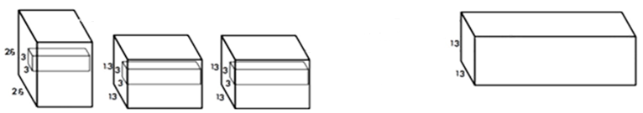
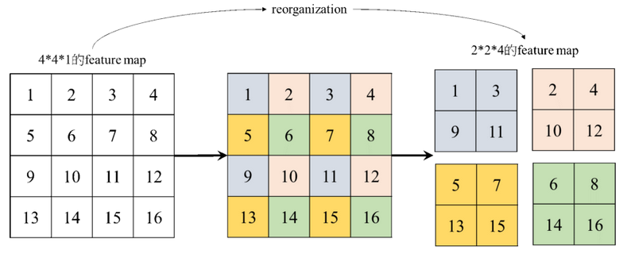
0.2.2 Path-Through of YoloV2
Turns 26x26x512 to 13x13x2048
Concatenation
+
13x13x(2048+1024)
= 3072
13x13x1024
Down-sampling
(6) Fine-grained feature detector.
Fig. Path-through of YOLOv2
Let’s see simple example: turn 4x4x1 to 2x2x4.
Fig. Reorganization process example

Slide 7
0. YoloV1 and YoloV2 Tommy
1. YoloV2 Analysis Differences from Version1 1. Batch Normalization-Add batch normalization to all convolutional layers 2. High Resolution Classifier-By learning the classfication network first with ImageNet data, it works well with high resolution images. 3. Convolutional-Replace FCL (Fully Conneted Layer) with Convolution Layer 4. Anchor Boxes-Predict the bounding box directly from the beginning -> Predict using the anchor box as the initial value 5. new network-Use Darknet-19 as a feature extractor 6. Dimension Clusters-Find the best anchor box by clustering the actual bounding boxes 7. Location prediction-Constrain the bounding box not to deviate from the grid cell 8. passthrough-skip the 26x26 middle feature map and attach it to the 13x13 layer (concatenate) 9. Multi-Scale Training-Resize the training data to 320x320, 352x352, ..., 608x608 while training on various scales 10. Fine-Grained Features-Increase the size of the final feature map from 7x7 to 13x13
Notes:
1. Batch Normalization - 모든 컨볼루션 레이어에 배치 정규화를 추가
2. High Resolution Classifier - ImageNet 데이터로 classfication network를 먼저 학습시켜서 고해상도 이미지에도 잘 동작하게 함
3. Convolutional - FCL(Fully Conneted Layer)를 Convolution Layer로 대체
4. Anchor Boxes - 경계 박스를 처음부터 직접 예측 -> 앵커 박스를 초기값으로 사용하여 예측
5. new network - Darknet-19 를 특징 추출기로 사용
6. Dimension Clusters - 실제 경계 박스들을 클러스터링하여 최적의 앵커박스를 찾음
7. Location prediction - 경계 박스가 그리드 셀에서 벗어나지 않게 제약을 둠
8. passthrough - 26x26 크기의 중간 특징맵을 skip 하여 13x13레이어에 붙임(concatenate)
9. Multi-Scale Training - 학습데이터의 크기를 320x320, 352x352, ..., 608x608 로 resize 하면서 다양한 스케일로 학습시킴
10. Fine-Grained Features - 최종 특징맵의 크기를 7x7에서 13x13으로 키움

Slide 8
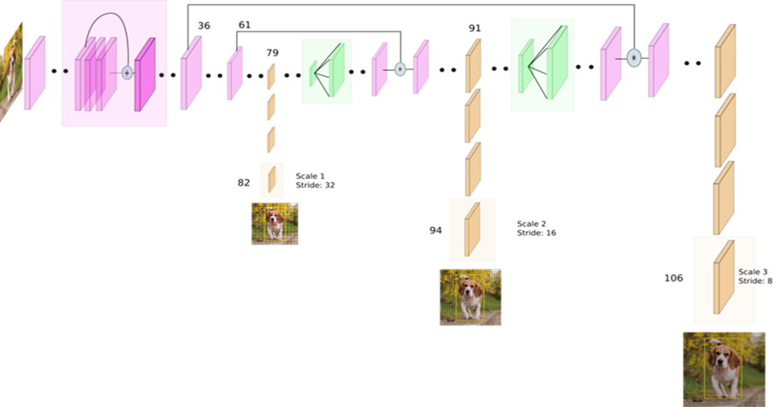
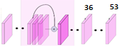
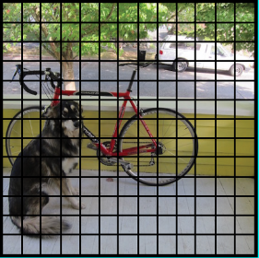
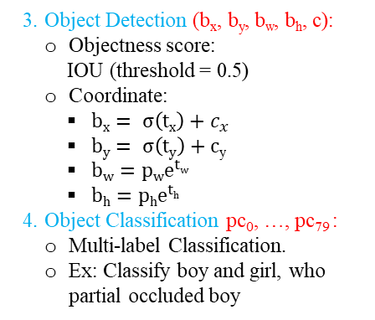
0. YoloV3
3. YoloV3
(1.3) Skip connection from 36th layer
(1.3) Skip connection from 61st layer
(1.1) Residual Blocks
(1.2) Up-sampling
(1.2) Up-sampling
Feature extractor based on Darknet-53 model
?? Divide to 3 scaling grid cells:
3 Grid scales, total grids/scale | Cell position (top-left) at image coord.
13x13 | C^{cell1}
26x26 | C^{cell2}
52x52 | C^{cell3}
C^{anc1}
C^{cell1}
??o/P
Stage 1 (13x13x255c)
??o/P
Stage 2 (26x26x255c)
1. YoloV3 Model:
Backbone: DarkNet-53.
75 convolutional layers.
106 fully convolutional layers.
2. Detection Across 3 Scaling Grid Cells:
Output 3 Scales: 13x13, 26x26, 52x52 grid cells
The same number of channels for each cell at one scale:
(4 + 1 + 80) x 3 anchor boxes/cell = 255c
C^{anc2}
C^{cell2}
3. Object Detection (b_{x}, b_{y}, b_{w}, b_{h}, c):
Objectness score:
IOU (threshold = 0.5)
Coordinate:
$bx= σ\left(tx\right)+c_{x}$
$by= σ\left(ty\right)+c$_{y}
$bw=p{we}^{tw}$
$bh=p{he}^{th}$
4. Object Classification pc₀, …, pc₇₉ :
Multi-label Classification.
Ex: Classify boy and girl, who partial occluded boy
??o/P
Stage 3 (52x52x255c)
C^{anc3}
C^{cell3}
5. 9 Anchor Boxes and Dimension Clusters.
(3 Anchor Boxes/cell) C^{anc1}, C^{anc2}, C^{anc3}
Total output bounding boxes:
(13x13+26x26+52x52) cells x 3 Anchor Boxes/cell = 10,647
(3 Anchor Boxes/cell at each scale grid cell)
t_{x}, t_{y}, t_{w}, t_{h}, t_{O} : BBox Geo. Inform (Cell coordinate).
b_{x}, b_{y}, b_{w}, b_{h}, c: BBox Geo. Inform (Image coordinate).
pc₀, pc₂, …, pc₇₉: Probabilities of object classes / BBox.
[Ref] https://towardsdatascience.com/yolo-v3-object-detection-53fb7d3bfe6b

Slide 9
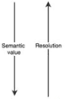
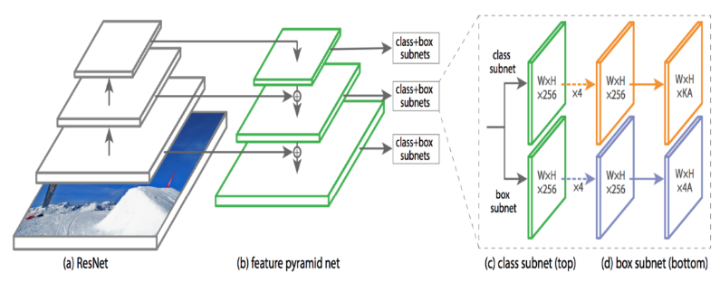
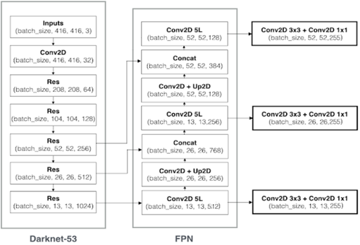
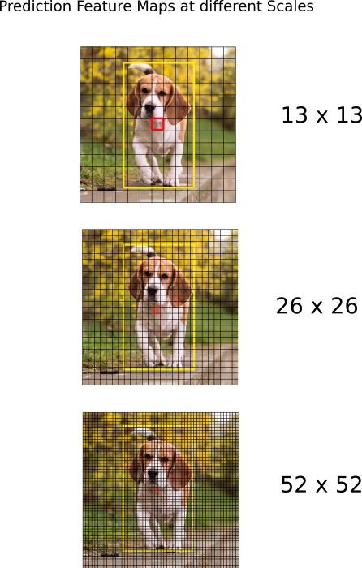
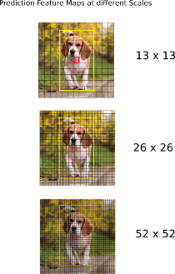
1.2.3 Related Works – RetinaNet Vs. YoloV3 – YoloV3
RetinaNet and YoloV3 both
use Feature Pyramid Network (FPN))
3.3 YoloV3 Model for Detection and Classification Tasks jj
a. Feature Extractor (1/3): (Feature Pyramid Network (FPN))
The feature maps are taken from earlier layers by up-sampling 2x and concatenation.
Allow get more meaningful semantic information from the upsampled features and finer-granied information from earlier feature map.
Element-wise addition (FPN).
[Phu] YoloV3 uses concatenation, instead.
Feature Pyramid Network (FPN)
Top-down pathway: feedforward computation of the backbone ConvNet
Bottom-up pathway: upsample the coarser-resolution feature map by a factor of 2 (using linear interpolation upsampling for simplicity)
Lateral connections: The upsampled map is merged with the feature map from 36th and 61th layer by addition.
Feature extraction
Detection & Classification
Fig. Feature Pyramid Network
Feature Extraction
Detection and Classification
104th, 105th +
106th
103rd
Concatenate with layer 36th
Stage 3
(52x52x255c)
Upsampling
92nd , 93rd +
94th
91st
O/P
Skip connection
From layer 36th
?? 26x26
Stage 2
(26x26x255c)
Concatenate with layer 61th
Skip connection
From layer 61st
Upsampling
80th , 81st +
82th
O/P
Total output predictions:
(13x13+26x26+52x52) grid cells x 3 anchor boxes/cell
= 10,647 boxes
79th
Stage 1
(13x13x255c)
Residual Blocks
75th
O/P
Fig. YoloV3 Network based on Feature Pyramid
Notes:
Fine grained : 어떤 대상을 잘게 쪼개는 것.(세분화)
Coarse grained : 어떤 대상을 듬성듬성 하게 쪼개는 것.

Slide 10
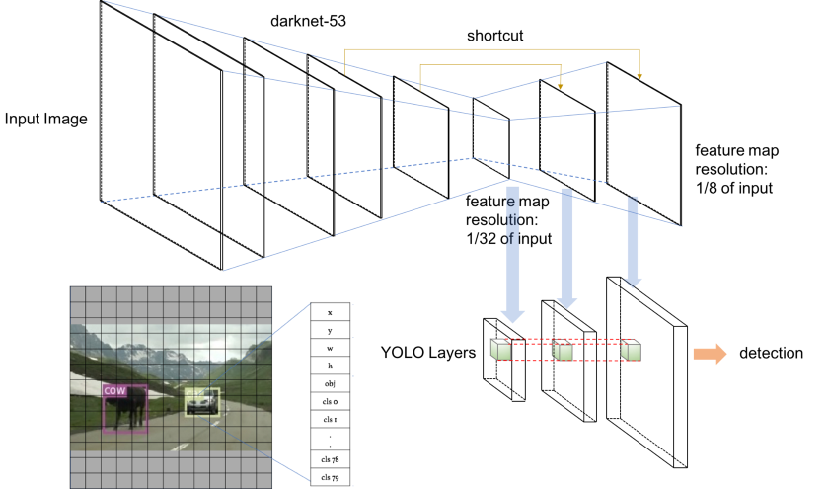
0.2.3 YoloV3 in 3D Scenes ??
Output:
Multi-Subnets: Detection Part –
Bbox Regression (continue) Subnet and Classification (discrete) Subnet

Slide 11

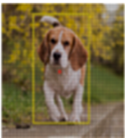
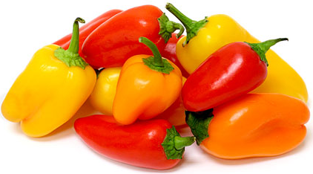
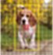
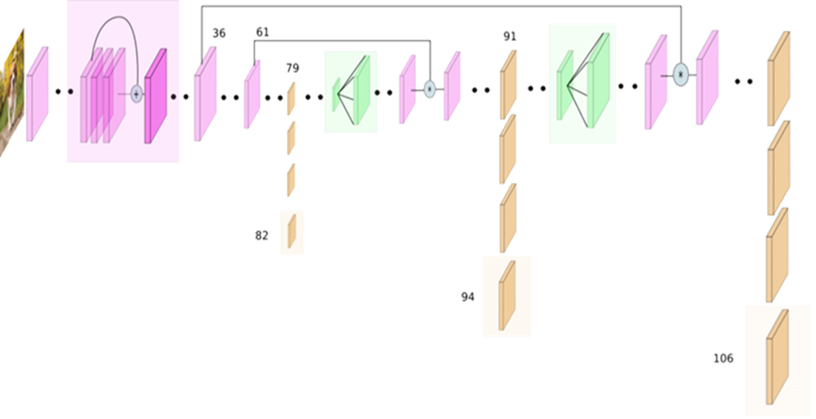
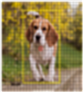
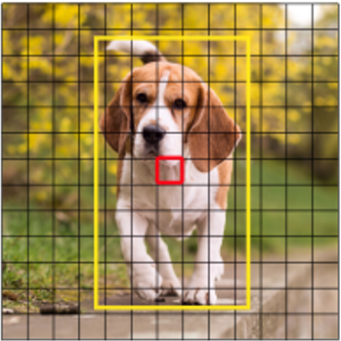
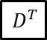
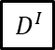
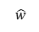
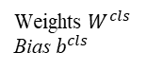
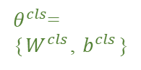
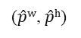
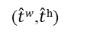

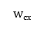
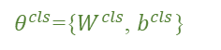
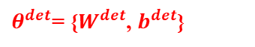
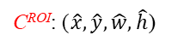
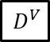
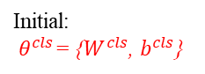
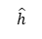
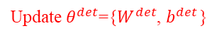
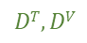
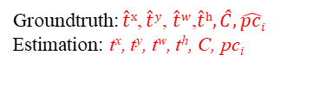
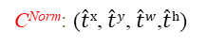
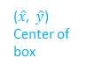
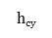
0. Framework of Training Process for YOLOv3
*BBox: Bounding Box contains Defects
INPUT DATASET: COCO+ImageNet
Tab. Dataset and Data Split
1. Pre-train DarkNet-53 by ImageNet (Classification):
COCO D^{C}
ImageNet D^{I}
Type |  | NB Images
ImageNet D^{I} |  | 1,331,167
COCO D^{C} | Train D^{T} + Valid D^{V} | 118,287
 | Test D^{TE} | 20,288
$θ^{cls}$=
{$W^{cls}$, $b^{cls}$}
$$D^{I}$$
Feature Extraction
Weights $W^{cls}$
Bias $b^{cls}$
DarkNet53 Model
$${Update: θ}^{cls}$$
$$DT, DV$$
$θ^{cls}$={$W^{cls}$, $b^{cls}$}
0.1 Grid Division, ROI/Object Normalization w/ Labeling:
2. Training Process using Gradient Descent Optimization:
(1) Divide to 3 Scaling Grid Cells:
2.1 YoloV3 Model based on DarkNet-53 for Detection and Classification:
3 Grid scales, total grids/scale?? | Top-left Cell Position at Image Coord.
13x13 | C^{cell1}(c_{x},c_{y})
26x26 | C^{cell2}(c_{x},c_{y})
52x52 | C^{cell3}(c_{x},c_{y})
$$D^{T}$$
416x416 pixels
train_counter.append(
(batch_idx*64) + ((epoch-1)*len(train_loader.dataset))
)
$$D^{V}$$
DarkNet-53
Feature Extraction
$$\hat{w}$$
(2) Normalize Object ROIs to Cell Coordinates:
Initial:
$θ^{cls}$= {$W^{cls}$, $b^{cls}$}
(c_{x},c_{y})
(Top-left of cell)
C^{anc2}
$$wcx$$
C^{ROI}: ($\hat{x}, \hat{y},\hat{w},\hat{h}$)
C^{celli} C^{Norm}
C^{anc1}
C^{cell1}
$$\hat{h}$$
C^{cell2}
$$hcy$$
($\hat{x}$, $\hat{y}$)
Center of box
Normalize function
O/P
B_{obj}, C_{obj}
O/P
B_{obj}, C_{obj}
C^{anc3}
C^{Norm}: ($\hat{t}x$, $\hat{t}y$, $\hat{t}w$,$\hat{t}h$)
Stage 1 (13x13x255c)
Stage 2 (26x26x255c)
C^{cell3}
C^{Norm}
Valid
Check
Bounding box coordinate: B_{obj}: (t^{x}, t^{y}, t^{w}, t^{h}, C)_{kx5}
Probability of each Class: C_{obj}: (pc₀, ... pc₇₉) _{kx80}
O/P
B_{obj}, C_{obj}
0.2 9 Anchor Boxes Generation using K-means Clustering:
Stage 3 (52x52x255)
(3 scales, 3 anchor boxes/cell at each scale)
$\text{Update} θ^{det}$={$W^{det}$, $b^{det}$}
B_{obj}: (t^{x}, t^{y}, t^{w}, t^{h}, C)_{kx5}
C_{obj}: (pc₀, ... pc₇₉) _{kx80}
K-Means Clustering:
(Generate 3x3=9 different w:h ROI ratio sizes)
C^{anc1}
2.2 YoloV3 Loss function
Groundtruth: $\hat{t}x$, $\hat{t}y$, $\hat{t}w$,$\hat{t}h,\hat{C}, \hat{pci}$
Estimation: t^{x}, t^{y}, t^{w}, t^{h}, C, pc_{i}
C^{anc}
L = L_{reg} + L_{obj} + L_{cls}
L_{reg}: Location Loss function (t*)
L_{obj}: Objectness/No_Obj Score Loss function. (C)
L_{cls}: Class Estimation Loss function. (pc_{i})
C^{Norm}
C^{anc}
C^{anc2}
After training
($\hat{t}w$,$\hat{t}h$)
($\hat{p}w$, $\hat{p}h$)
$θ^{det}$= {$W^{det}$, $b^{det}$}
C^{anc3}

Slide 12
Content
0. Roadmap
Introduction:
1.1 Motivation: Motivation, Objective and Global Framework
1.2 Related Works
1.3 Contribution
System Setup and Functions
2.1 System Setup.
2.2 Function Specifications.
3. Frameworks
3.1 Training Process.
3.2 Inference Process.
3.3 Methodology.
4. Experimental Results
4.1 Data Collection
4.2 Experimental Results
4.3 Ablation
5. Conclusion
R. Reference
A. Appendix
Q. Q&A
Notes:
那這裡是我的大綱，首先我會先報告我的動機，接著第二到三章會詳述我的方法，最後附上實驗結果和在刀具瑕疵上的應用

Slide 13
1.1 Introduction (1/3): Motivation, Objectives
Motivation
Most of the modern accurate models require many GPUs for training with a large mini-batch size, and doing this with one GPU makes the training really slow and impractical.
There are still a huge number of features which are said to improve Convolutional Neural Network (CNN) accuracy.
Objectives:
Combine new features to form a new Deep Learning-based Object Detection Model called YOLOv4.
Making an object detector which can be trained on a single GPU with a smaller mini-batch size and run smoothly on the edge devices (low-cost hardware).
Achieve state-of-the-art results (trade-off btw performance and speed) : 43.5% AP (65.7% AP50) for the MS COCO dataset at a real-time speed of ∼65 FPS on Tesla V100.
Figure 1: Comparison of the proposed YOLOv4 and other state-of-the-art object detectors.
YOLOv4 runs twice faster than EfficientDet with comparable performance.
YOLO is able to run at a much higher speed (> 60 FPS) with very good accuracy
EfficientDet D4-D3 achieves better AP than YOLO v4 models, but they run at speed of < 30 FPS on a V100 GPU
Improves YOLOv3’s AP and FPS by 10% and 12%, respectively

Slide 14
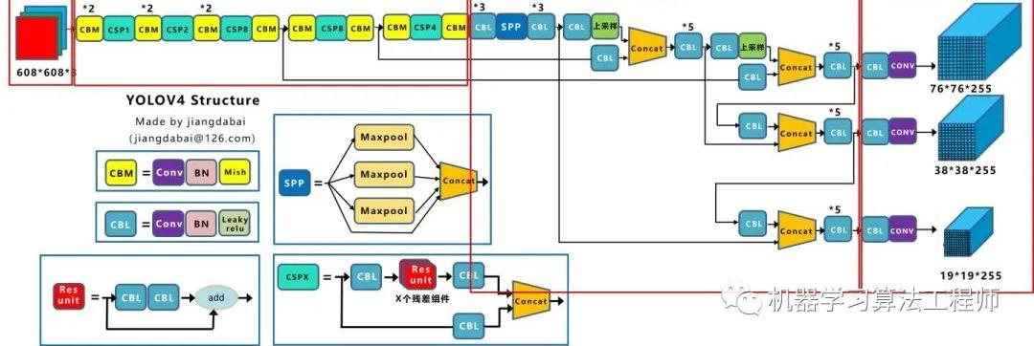
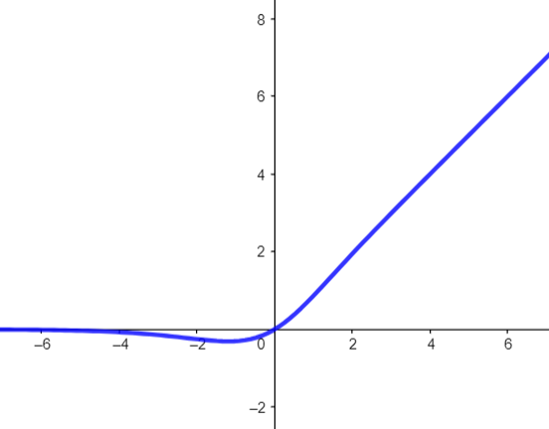
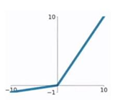
1.1 Introduction (2/3): Global Framework ??
(0) Input (input image):
Image.
Backbone (extracts the feature maps):
CSPDarknet53 [81].
Neck (enhance the feature discriminability and robustness):
Additional blocks: Spatial Pyramid Pooling SPP [25].
Path-aggregation blocks: modified PANet [49].
Head (handles the Bboxes prediction and Categories classification):
Dense Prediction (one-stage): same as YOLOv3 [61]
Cross-Stage-Partial-connections (CSP):
Global Frameworks:
YOLOv4 (One-stage Object Detector)
Detector
SPP
608x608x3c pixels
(0) Input
(1) Backbone
(2) Neck
(3) Head
3. Multi-Subnets: Detection Part –
Bbox Regression (continue) Subnet and Classification (discrete) Subnet
Fig. Overview of one-stage object detector
(1) Backbone: CSPDarknet53
P5:19²
(3) Head
(0) Input
C1:304²
C2:152²
C3:76²
C4:38²
C5:19²
(2) Neck: SPP+PAN
P4:38²
P3/N3:76²
Stage:Size²
19x19x255c??
N4:38²
SPP
Route -18
N5:19²
Route -41
76x76x255c??
Cross Stage Partial connections (CSP):
[Tony] output size is correct
Fig. Parts of YOLOv4
https://www.ershicimi.com/p/e69e2ecd5d85ebec098ce8b8e07d15b3
May some errors but looks good??

Slide 15

1.1 Introduction (3/3): Global Framework – details
文
CBM
Conv: Convolution Layer. It is used to extract features in images.
BN: Batch Normalization. It normalizes each layer’s inputs by fixing means and variances. It solves the gradient vanishing problem and achieves better convergence speed.
Mish: Mish activation function. It is a smooth function and preserves small negative inputs, which is easier to optimize and hence the network generalizes better.
CBL: similar to CBM, but the activation function is Leaky ReLU instead of Mish.
Leaky ReLU: It is a modified version of ReLU. It preserves negative inputs and solves gradient vanishing problem.
CSPX: Cross Stage Partial Connections (“X” stands for the number of ResUnits)
Input feature maps will be divided into 2 parts. The first part goes through CBLs and ResUnits. The second part goes through a CBL and becomes part of the input to the next layer.
It not only retains the details on the image but also reduces the computational complexity.
ResUnit: Residual Unit (the building block of ResNet)
Input feature maps will go through 2 CBLs and a shortcut (not divided into 2 parts).
It solves gradient vanishing problem and allows the network to get deeper.
SPP: Spatial Pyramid Pooling
It is composed of multiple max-pooling layers.
It increases receptive fields to get more features and separates out the most significant context features.
CBM
=
Conv
BN
Mish
Mish
CBL
=
Conv
BN
Leaky
relu
Leaky ReLU
ReLU
CSPX
=
CBL
Res Unit
CBL
X個ResUnit
Concat
CBL
Res Unit
=
CBL
CBL
add
Maxpool
SPP
=
Maxpool
Concat
Maxpool

Slide 16

YOLOv4 Demonstration
(0) Input (input image):
Image.
Backbones (takes as input the image and extracts the feature maps):
CSPDarknet53 [81].
Neck (sub-sets of the backbone - enhance the feature discriminability and robustness):
Path-aggregation blocks: modified PANet [49].
Additional blocks: Spatial Pyramid Pooling [25].
Heads (handles the Bboxes prediction and Categories classification):
YOLOv4 (One-stage Object Detector)
Bottom-up
Top-down
Bottom-up
1) Feature Extraction (CSPDarknet53)
2) Feature Pyramid Network (FPN)
3) Bottom-up Path Aggregation
4) heads
19x19x512c
SPP
19x19x2048c
Bboxes are scaled to input size.
NMS is at input image size
1x1 conv
1x1 conv
N5
convs
Det 5
Stage 3: Large Object Detector
19x19x512c
C5
P5
19x19x1024c
19x19x27c
N4
Det 4
19x19x1024c
19x19x1024c
Downsample by conv
convs
Stage 2: Medium Object Detector
C4
Upsample
38x38x512c
38x38x27c
P4
1x1 conv
N3
Det3
38x38x512c
Downsample by conv
convs
Stage 1: Small Object Detector
C3
38x38x512c
Upsample
P3
76x76x256c
76x76x27c
1x1 conv
76x76x256c
C2
76x76x256c
copy
Small feature maps => more global feature
Large object detector => large bboxes
152x152x128c
C1
[J]: Why not use c1 and c2??
[P]: C1 and C2 have not enough semantic information and maybe contain noises, while the spatial resolution is high that cost a lot of memory and slow down process.
Beside, information was already preserved by CSP connections. (CSPDarknet53)
304x304x64c
Input
608x608x3c
concatenation
3. Multi-Subnets: Detection Part –
Bbox Regression (continue) Subnet and Classification (discrete) Subnet
Figure. YOLOv4 (One-stage Object Detector)

Slide 17

YOLOv4: Output Prediction
文
4 predicted Bbox offsets: t_{x}, t_{y}, t_{w}, t_{h}
Confident score: c
4 detect type of class probability: pc₀ ,pc₁, pc₂, pc₃
Pre-defined anchor box size: p_{w}, p_{h}
4 output Bbox coordinates: b_{x}, b_{y}, b_{w}, b_{h}
9 anchor ratios (scale) by K-means for 3 stages (3 ratios/ stage)
Input channel size = (4 coordinates + 1 confidence score + 4 categories) x 3 = 27 channels/ stage
文: Actually, the channel size depends on how many categories you want to classify data into
Pre-defined 8th Anchor (p_{w}, p_{h})
Det 5-1
Reg
Det’ 5-1
Stage 3: Large Object Detector
Det 5
19x19x9c
Pre-defined 7 th Anchor (p_{w}, p_{h})
19x19x9c
Det 5-2
Det’ 5-2
Stage Prediction
Reg
19x19x9c
Pre-defined 6th Anchor (p_{w}, p_{h})
19x19x9c
After merging from 3 stage (3 scales), the NMS process will be applied to suppress the overlapping boxes
NMS (non-maximum suppression):
Pick the box with largest C
Discard any remaining box with IoU $≥$ threshold
19x19x27c
Det 5-3
Reg
Det’ 5-3
Stage 2: Medium Object Detector
19x19x9c
隆: Convert to image space by regression
19x19x9c
Det 4
b_{x}
b_{y}
b_{w}
b_{h}
C
P_{c0}
P_{c1}
P_{c2}
P_{c3}
t_{x}
t_{y}
t_{w}
t_{h}
C
P_{c0}
P_{c1}
P_{c2}
P_{c3}
隆: Grid space bounding box
(offset to anchor)
38x38x27c
Stage 1: Small Object Detector
Det 3
隆: Image space bounding box coordinates
72x72x27c
76x76x27c
Figure. YOLOv4 output prediction

Slide 18

1.2.1 Related Works: Object Detection Models ??
文
(0) Input
(1) Backbone
(2) Neck
(3.1) One-stage Heads
(3.2) Two-stage Heads
Object Detection can be divided into 2 kinds:
One-Stage: anchor based vs anchor free.
Two-Stage: anchor based vs anchor free.
The right side is all of technologies that the author have been evaluated, modified and integrated into YOLOv4.
文: The technologies tested in the research of YOLOv4
文: The parts an ordinary object detector is composed of

Slide 19
1.2.2 Related Works: Overview of Improvement Methods
文
Bag of freebies (BoF):
Improvements without impact on inference speed.
Made in the traininng process (off-line training) to advance accuracy, include:
1.1) Data Augmentation.
1.2) Solving Class Imbalance.
1.3) Adjusting Loss Functions.
Bag of specials (BoS):
Improvements impacts the inference time slightly with a good return in performance.
Include:
2.1) Enhance receptive field: SPP [25], ASPP [5], and RFB [47].
2.2) Introduce attention mechanism: SE [29] and SAM [85]
2.3) Strengthen feature integration: Skip connection [51], hyper-column [22], SFAM [98], ASFF [48], and BiFPN [77]
2.4) Activation functions: ReLu [56], LReLU [54], PReLU [24], ReLU6 [28], SELU [35], Swish [59], hard-Swish [27], and Mish [55].
2.5) Post processing: Greedy NMS [19], Soft NMS [1] and DIoU NMS [99].
文: Only change the training strategy or only increase the training cost.

Slide 20


1.2.3 Related Works: Bag of Freebies (BoF)
文
1.1) Data augmentation:
Purpose:
Increase the variability of the input images.
The designed object detection model has higher robustness to the images obtained from different environments.
Categories:
(1) Pixel-wise adjustments:
Photometric distortions:
Adjust the brightness, contrast, hue, saturation, and noise of an image
Geometric distortions:
Add random scaling, cropping, flipping, and rotating.
(2) Object occlusion:
Apply to input image:
Random erase [100] and CutOut [11]: randomly select the rectangle region in an image and fill in a random or complementary value of zero.
Hide-and-seek [69] and grid mask [6]: randomly or evenly select multiple rectangle regions in an image and replace them to all zeros.
Apply to feature maps:
DropOut [71], DropConnect [80], and DropBlock [16] methods.
(3) Mixing multiple images together:
MixUp [92]: uses two images to multiply and superimpose with different coefficient ratios and adjusts the label with these superimposed ratios.
CutMix [91]: cover the cropped image to rectangle region of other images and adjusts the label according to the size of the mix area.
(4) Style transfer GAN [15]: effectively reduce the texture bias learned by CNN.
Fig. Geometric distortions
Fig. Object occlusion
文: Similar concepts.
文: Texture bias: the texture has huge amount of influence on CNN’s predictions

Slide 21
1.2.3 Related Works: Bag of Freebies (BoF)
1.1) Data augmentation:
Purpose:
Increase the variability of the input images.
The designed object detection model has higher robustness to the images obtained from different environments.
Categories:
(1) Pixel-wise adjustments:
Photometric distortions:
Adjust the brightness, contrast, hue, saturation, and noise of an image
Geometric distortions:
Add random scaling, cropping, flipping, and rotating.
(2) Object occlusion:
Apply to input image:
Random erase [100] and CutOut [11]: randomly select the rectangle region in an image and fill in a random or complementary value of zero.
Hide-and-seek [69] and grid mask [6]: randomly or evenly select multiple rectangle regions in an image and replace them to all zeros.
Apply to feature maps:
DropOut [71], DropConnect [80], and DropBlock [16] methods.
(3) Mixing multiple images together:
MixUp [92]: uses two images to multiply and superimpose with different coefficient ratios and adjusts the label with these superimposed ratios.
CutMix [91]: cover the cropped image to rectangle region of other images and adjusts the label according to the size of the mix area.
(4) Style transfer GAN [15]: effectively reduce the texture bias learned by CNN.
Fig. Geometric distortions
Fig. Object occlusion

Slide 22

1.2.3 Related Works: Bag of Freebies (BoF)
文
1.2) Solving Class Imbalance:
Purpose:
Solving the problem that the semantic distribution in the dataset may have bias.
Data imbalance between different classes.
Methods:
Two-stage object detector:
Hard negative example mining [72].
Online hard example mining [67].
One-stage object detector:
Focal loss [45]: Binary Cross Entropy with a modulating factor that reduces the loss contribution from easy examples.
Label smoothing [73]: convert hard label into soft label for training.
Label refinement network [33]: obtain a better soft label.
文: Find the negative examples that the model always detect it incorrectly (false positive) and add it to the set of negative samples.
文: Find the examples (not limited to negative examples) that the model always detect it incorrectly (false positive) and add it to the set of negative samples.
$$Focal Loss= FL\left(p_{t}\right)=−α{\left(1−p_{t}\right)}^{γ}\log\left(p_{t}\right), where α and γ is a constant,γ≥0$$
$$p_{t}=\left\{\begin{aligned}p if y=1 \\ 1−p otherwise\end{aligned}\right.$$
文: This is a network that predicts segmentation labels at multiple resolutions, mentioned by the authors of YOLOv4.
隆:
It is difficult to express the relationship of the degree of association between different categories with the one-hot hard representation

Slide 23




1.2.3 Related Works: Bag of Freebies (BoF) ??
隆
補充 Cross Entropy 和 Focal Loss 的關係:
Cross Entropy:
α-balanced Cross Entropy:
Focal Loss:
𝛾 is called focusing parameter ($\text{γ} \text{≥}\text{ 0}$)
When 𝛾 = 0, Focal Loss is equivalent to CE
In this paper, 𝛾 = 2 works best
α-balanced Focal Loss:
Focal Loss 的主要目的是降低容易分辨的 example 在 loss function 中的比重 (${ p}_{t} >0.5$)
容易分辨的例子為整個 Bounding Box 僅框到背景的部分
讓整體的 loss 更注重在難以分辨的 example 上
難以分辨的例子為 Bounding Box 包含了部分背景與要偵測之物件
$$Cross Entropy=CE\left(p_{t}\right)=−\log\left(p_{t}\right)$$
$$p_{t}=\left\{\begin{aligned}p if y=1 \\ 1−p otherwise y=−1\end{aligned}\right.$$
$$α−balanced Cross Entropy=−α_{t}log\left(p_{t}\right),$$
$$α_{t}=\left\{\begin{aligned}α if y=1 \\ 1−α otherwise\end{aligned}\right.,α∈[0, 1]$$
$α$ $are usually set by inverse class frequency or treated as a hyperparameter$
Hard example Vs. Easy example
$$Focal Loss=FL\left(p_{t}\right)=−{(1 −p_{t})}^{γ}log\left(p_{t}\right)$$
$$α−balanced Focal Loss=−α_{t}{\left(1 −p_{t}\right)}^{γ}log\left(p_{t}\right)$$
Reference: Focal Loss for Dense Object Detection

Slide 24
1.2.3 Related Works: Bag of Freebies (BoF)
1.2) Solving Class Imbalance:
Purpose:
Solving the problem that the semantic distribution in the dataset may have bias.
Data imbalance between different classes.
Methods:
Two-stage object detector:
Hard negative example mining [72].
Online hard example mining [67].
One-stage object detector:
Focal loss [45].
Label smoothing [73]: convert hard label into soft label for training.
Label refinement network [33]: obtain a better soft label.

Slide 25

1.2.3 Related Works: Bag of Freebies (BoF)
1.3) Adjust Loss Functions:
Purpose:
Adjust the objective function (loss function) of Bounding Box (BBox) regression.
Traditional method: Mean Square Error (MSE)
Anchor free: Directly perform regression the Bbox coordinates:
The center point coordinates and height and width: {x_{center}, y_{center}, w, h}.
The upper left point and the lower right point: {x_{top_left}, y_{top_left}, x_{bottom_right}, y_{bottom_right}}.
Anchor-based: Estimate the corresponding offset:
{x_{center_offset}, y_{center_offset}, w_{offset}, h_{offset}}.
{x_{top_left_offset}, y_{top_left_offset}, x_{bottom_right_offset}, y_{bottom_right_offset}}.
Methods:
IoU loss [90]: Puts the coverage (IoU) of predicted BBox area and ground truth BBox area into consideration.
GIoU loss [65]: Include the shape and orientation of object in addition to the coverage area.
DIoU loss [99]: Considers the distance of the center of an object
CIoU loss [99]:
Considers the overlapping area, the distance between center points, and the aspect ratio.
CIoU can achieve better convergence speed and accuracy on the BBox regression problem.

Slide 26

1.2.3 Related Works: Bag of Freebies (BoF)
隆: To directly estimate the coordinate values of each point of the BBox is to treat these points as independent variables, but in fact does not consider the integrity of the object itself.
1.3) Adjust Loss Functions:
Purpose:
Adjust the objective function (loss function) of Bounding Box (BBox) regression.
Traditional method: Mean Square Error (MSE)
Anchor free: Directly perform regression the Bbox coordinates:
The center point coordinates and height and width: {x_{center}, y_{center}, w, h}.
The upper left point and the lower right point: {x_{top_left}, y_{top_left}, x_{bottom_right}, y_{bottom_right}}.
Anchor-based: Estimate the corresponding offset:
{x_{center_offset}, y_{center_offset}, w_{offset}, h_{offset}}.
{x_{top_left_offset}, y_{top_left_offset}, x_{bottom_right_offset}, y_{bottom_right_offset}}.
Methods:
IoU loss [90]: Puts the coverage (IoU) of predicted BBox area and ground truth BBox area into consideration.
GIoU loss [65]: Include the shape and orientation of object in addition to the coverage area.
DIoU loss [99]: Considers the distance of the center of an object
CIoU loss [99]:
Considers the overlapping area, the distance between center points, and the aspect ratio.
CIoU can achieve better convergence speed and accuracy on the BBox regression problem.
隆:
Why is offset here? In page 31, bounding box would already be in (x, y, w, h) form when calculating loss. ??
隆: When using coordinates of BBox, $L_{1}$ and $L_{2}$ loss increases with the scale.
But IoU is scale invariant, does not get affected by scale.

Slide 27

1.2.3 Related Works: Bag of Freebies (BoF) ??
1.4) Regularization Techniques:
Purpose:
Avoid over-fitting.
Methods (Similar to data augmentation that are applied on the feature maps): (*Applied in YOLOv4- explain later)
DropOut ??
DropConnect ??
DropBlock[13]: (*Applied in YOLOv4- explain later).
DropOut : Delete Node, so that delete connection.
DropConnect : Remain Node but delete connection.
Tommy

Slide 28




1.2.4 Related Works: Bag of Specials (BoS)
文
2.1) Enhance receptive field: SPP [25], ASPP [5], and RFB [47]
Spatial Pyramid Pooling (SPP) [25]:
Integrates Spatial Pyramid Matching (SPM) [39] into the CNN to output one fixed-size dimensional feature vector.
From YOLOv3 [63], Redmon and Farhadi also integrated the improved SPP module between the Backbone and FPN to form the YOLOv3-SPP.
YOLOv3-608-SPP upgrades AP50 by 2.7% at the cost of 0.5% extra computation.
Atrous Spatial Pyramid Pooling (ASPP) [5]:
The ASPP is the SPP module with dilated convolution operation.
Receptive Field Block (RFB) [47]:
Improve dilated convolution to obtain more comprehensive spatial coverage of feature maps.
RFB [47] only costs 7% extra inference time to increase the AP50 of SSD by 5.7% on MS COCO .
Fig. DC-SPP-YOLO An example of how SPP is applied into YOLOv2
[Ref]: https://arxiv.org/abs/1903.08589
文: The max-pooling operations are replaced by dilated convolution operations.
Fig. A comparison of YOLOv3 family
[Ref]: https://pjreddie.com/darknet/yolo/
文: Ordinary convolution + dilated convolution
文: Human visual system
pRF: human population
Receptive Field
Construction of the RFB module by combining multiple branches with different kernels and dilated convolution layers. Multiple kernels are analogous to the pRFs of varying sizes, while dilated convolution layers assign each branch with an individual eccentricity to simulate the ratio between the size and eccentricity of the pRF. With a concatenation and 1×1 conv in all the branches, the final spatial array of RF is produced.
imitate
Fig. ASPP with dilated convolutional layers
Fig. RFB - Receptive Field Block
[Ref]: https://link.springer.com/chapter/10.1007/978-3-030-01252-6_24

Slide 29
1.2.4 Related Works: Bag of Specials (BoS)
2.1) Enhance receptive field: SPP [25], ASPP [5], and RFB [47]
Spatial Pyramid Pooling (SPP) [25]:
Integrates Spatial Pyramid Matching (SPM) [39] into the CNN to output one fixed-size dimensional feature vector.
From YOLOv3 [63], Redmon and Farhadi also integrated the improved SPP module between the Backbone and FPN to form the YOLOv3-SPP.
YOLOv3-608-SPP upgrades AP50 by 2.7% at the cost of 0.5% extra computation.
Atrous Spatial Pyramid Pooling (ASPP) [5]:
The ASPP is the SPP module with dilated convolution operation.
Receptive Field Block (RFB) [47]:
Improve dilated convolution to obtain more comprehensive spatial coverage of feature maps.
RFB [47] only costs 7% extra inference time to increase the AP50 of SSD by 5.7% on MS COCO .
Fig. DC-SPP-YOLO An example of how SPP is applied into YOLOv2
[Ref]: https://arxiv.org/abs/1903.08589
Fig. A comparison of YOLOv3 family
[Ref]: https://pjreddie.com/darknet/yolo/
Construction of the RFB module by combining multiple branches with different kernels and dilated convolution layers. Multiple kernels are analogous to the pRFs of varying sizes, while dilated convolution layers assign each branch with an individual eccentricity to simulate the ratio between the size and eccentricity of the pRF. With a concatenation and 1×1 conv in all the branches, the final spatial array of RF is produced.
Fig. ASPP with dilated convolutional layers
Fig. RFB - Receptive Field Block
[Ref]: https://link.springer.com/chapter/10.1007/978-3-030-01252-6_24

Slide 30


1.2.4 Related Works: Bag of Specials (BoS) 2.1.1) SPPNet [11] ??
To allow the input image size from fixed size to any size, this paper improve the pooling layer, which is the last one of convolution layer or the one before the fully connector layers
(Spatial Pyramid Pooling Net)
So improve pooling layer,
J: different strides and window sizes??
Advantages:
Convolution is done only once for an image regardless of the number of object proposals
Stride and window sizes are flexible => Allows arbitrary input sizes
文: Yes.
8
8
for any size
6
6
Notes:
ILSVRC2012: ImageNET Large Scale Visual Recognition Challenge 2012

Slide 31


1.2.4 Related Works: Bag of Specials (BoS) 2.1.1) SPPNet [11] ??
(Spatial Pyramid Pooling Net)
文: The spatial pyramid pooling layer described here is different from the layer in YOLOv4.
Refer: K. He, X. Zhang, S. Ren, and J. Sun, “Spatial pyramid pooling in deep convolutional networks for visual recognition,” in ECCV, 2014.

Slide 32


1.2.4 Related Works: Bag of Specials (BoS) 2.2.1 Scene Understanding Model: Network Archiecture – ASPP (from DeepLabV3+)
ASPP: atrous spatial pyramid pooling
+ASPP
block 4
1x1 conv
14x14x512
Concatenate+ (1x1x(5x256))x256c conv ??
14x14x512
x3
3x3 conv
rate 12
Concatenation
o/p
14x14x2048
o/p maps:
14x14x2048c
3x3 conv
rate 24
o/p maps:
14x14x256c
3x3 conv
rate 36
5x(256x128x256)
256x128x512
(1x1x256)x256c ??
The shared feature map
for decoder
Image pooling
1x1 conv
Bilinear upsample
Figure source: DeeplabV3+ [3]
7x7x256c
o/p
14x14x256c
7x7x256c
# BxWxHxC * 1x1xCxdepth(256) -> BxWxHxdepth, default: padding = 'SAME'
at_pool1x1 = slim.conv2d(output_block4, depth, [1, 1], scope="conv_1x1_0", activation_fn=None)
# BxWxHxC * 3x3xCxdepth -> BxWxHxdepth, default: padding = 'SAME'
at_pool3x3_1 = slim.conv2d(output_block4, depth, [3, 3], scope="conv_3x3_1", rate=12, activation_fn=None)
# BxWxHxC * 3x3xCxdepth -> BxWxHxdepth, default: padding = 'SAME'
at_pool3x3_2 = slim.conv2d(output_block4, depth, [3, 3], scope="conv_3x3_2", rate=24, activation_fn=None)
# BxWxHxC * 3x3xCxdepth -> BxWxHxdepth, default: padding = 'SAME'
at_pool3x3_3 = slim.conv2d(output_block4, depth, [3, 3], scope="conv_3x3_3", rate=36, activation_fn=None)
# BxWxHxC -> Bx1x1xC: global average pooling
image_level_features = tf.reduce_mean(output_block4, [1, 2], name='image_level_global_pool', keep_dims=True)
# Bx1x1xC * 1x1xCxdepth -> Bx1x1xdepth
image_level_features = slim.conv2d(image_level_features, depth, [1, 1], scope="image_level_conv_1x1", activation_fn=None)
# Bx1x1xdepth -> BxWxHxdepth
image_level_features = tf.image.resize_bilinear(image_level_features, (feature_map_size[1], feature_map_size[2]))
# concatenate along the depth dim
output = tf.concat((at_pool1x1, at_pool3x3_1, at_pool3x3_2, at_pool3x3_3, image_level_features), axis=3, name="concat")

Slide 33


1.2.4 Related Works: Bag of Specials (BoS) 2.2.2 Atrous Spatial Pyramid Pooling (ASPP) (from DeepLabv3)

Slide 34



1.2.4 Related Works: Bag of Specials (BoS) ??
文
2.2) Introduce attention mechanism: SE [29] and SAM [85]. ??
(1) Squeeze-and-Excitation (SE) [29]:
Channel-wise attention.
SE module improve the power of ResNet50 in the ImageNet image classification task 1% top-1 accuracy at the cost of only increasing the computational effort by 2%,.
On a GPU, it increases the inference time by about 10%, so it is more appropriate to be used in mobile devices.
(2) Spatial Attention Module (SAM) [85]: ??
Spatial-wise attention.
Only needs to pay 0.1% extra calculation but improve ResNet50-SE 0.5% top-1 accuracy on the ImageNet image classification task.
It does not affect the speed of inference on the GPU.
文: FC & ReLU +
FC & Sigmoid
文: Global average pooling
(channel-wise)
文: Rescale U
Fig. A squeeze-excitation block
Fig. SAM module and how it is applied into Conv

Slide 35
1.2.4 Related Works: Bag of Specials (BoS) ??
2.2) Introduce attention mechanism: SE [29] and SAM [85]. ??
(1) Squeeze-and-Excitation (SE) [29]:
Channel-wise attention.
SE module improve the power of ResNet50 in the ImageNet image classification task 1% top-1 accuracy at the cost of only increasing the computational effort by 2%,.
On a GPU, it increases the inference time by about 10%, so it is more appropriate to be used in mobile devices.
(2) Spatial Attention Module (SAM) [85]: ??
Spatial-wise attention.
Only needs to pay 0.1% extra calculation but improve ResNet50-SE 0.5% top-1 accuracy on the ImageNet image classification task.
It does not affect the speed of inference on the GPU.
Fig. A squeeze-excitation block
Fig. SAM module and how it is applied into Conv

Slide 36
1.2.4 Related Works: Bag of Specials (BoS)
文: Repeated
2.1) Enhance receptive field: SPP [25], ASPP [5], and RFB [47]
Spatial Pyramid Pooling (SPP) [25]:
Integrates Spatial Pyramid Matching (SPM) [39] into CNN to output one fixed-size dimensional feature vector.
In YOLOv3 [63], Redmon and Farhadi improve SPP module to the concatenation of max-pooling outputs with kernel size k × k, where k = {1, 5, 9, 13}, and stride equals to 1.
YOLOv3-608-SPP upgrades AP50 by 2.7% on the MS COCO object detection task at the cost of 0.5% extra computation.
Atrous Spatial Pyramid Pooling (ASPP) [5]:
The ASPP is the SPP module with dilated convolution operation.
Receptive Field Block (RFB) [47]:
Improve dilated convolution to obtain more comprehensive spatial coverage of feature maps.
RFB [47] only costs 7% extra inference time to increase the AP50 of SSD by 5.7% on MS COCO .
Notes:
Receptive field : Area seen by filter (필터가 보는 영역, convolution 시 filter에 대응하는 영역)

Slide 37
1.2.4 Related Works: Bag of Specials (BoS)
文: Repeated
2.2) Introduce attention mechanism: SE [29] and SAM [85].
Squeeze-and-Excitation (SE) [29]:
Channel-wise attention.
SE module improve the power of ResNet50 in the ImageNet image classification task 1% top-1 accuracy at the cost of only increasing the computational effort by 2%,.
On a GPU, it increases the inference time by about 10%, so it is more appropriate to be used in mobile devices.
Spatial Attention Module (SAM) [85]:
Point-wise attention.
Only needs to pay 0.1% extra calculation but improve ResNet50-SE 0.5% top-1 accuracy on the ImageNet image classification task.
It does not affect the speed of inference on the GPU.

Slide 38


1.2.4 Related Works: Bag of Specials (BoS)
文
2.3) Strengthen feature integration: Skip connection [51], hyper-column [22], SFAM [98], ASFF [48], and BiFPN [77]:
Skip connection [51], hyper-column [22]:
Integrate low-level physical feature to high-level semantic feature.
SFAM [98], ASFF [48], and BiFPN [77]:
Integrate different feature pyramid (ideas from FPN)
SFAM [98]:
Use SE module to execute channel-wise level re-weighting on multi-scale concatenated feature maps.
ASFF [48]:
Use soft-max as point-wise level reweighting and then adds feature maps of different scales.
BiFPN [77]:
Use multi-input weighted residual connections to execute scale-wise level re-weighting, and then add feature maps of different scales
文: Early practice
文: SFAM
文: ASFF
文: BiFPN

Slide 39
1.2.4 Related Works: Bag of Specials (BoS)
2.3) Strengthen feature integration: Skip connection [51], hyper-column [22], SFAM [98], ASFF [48], and BiFPN [77]:
Skip connection [51], hyper-column [22]:
Integrate low-level physical feature to high-level semantic feature.
SFAM [98], ASFF [48], and BiFPN [77]:
Integrate different feature pyramid (ideas from FPN)
SFAM [98]:
Use SE module to execute channel-wise level re-weighting on multi-scale concatenated feature maps.
ASFF [48]:
Use soft-max as point-wise level reweighting and then adds feature maps of different scales.
BiFPN [77]:
Use multi-input weighted residual connections to execute scale-wise level re-weighting, and then add feature maps of different scales

Slide 40




1.2.4 Related Works: Bag of Specials (BoS)
文
1.4) Activation function:
Purpose: A good activation function can make the gradient more efficiently propagated and will not cause too much extra computational cost.
Methods:
ReLu [56]: solve the gradient vanish problem.
LReLU and PReLU: solve the problem that the gradient of ReLU is zero when the output is less than zero.
ReLU6 and hard-Swish: specially designed for quantization networks.
SELU: self-normalize a neural network.
Swish and Mish: continuously differentiable activation function.
文: A network that its precision is reduced.
ReLU
ReLU6
LReLU or PReLU
hard-Swish
Fig. ReLU, LReLU, and PReLU
Fig. ReLU6, and hard-Swish
SeLU
Swish
Mish
Fig. SeLU
Fig. Swish and Mish

Slide 41
1.2.4 Related Works: Bag of Specials (BoS)
1.4) Activation function:
Purpose: A good activation function can make the gradient more efficiently propagated and will not cause too much extra computational cost.
Methods:
ReLu [56]: solve the gradient vanish problem.
LReLU and PReLU: solve the problem that the gradient of ReLU is zero when the output is less than zero.
ReLU6 and hard-Swish: specially designed for quantization networks.
SELU: self-normalize a neural network.
Swish and Mish: continuously differentiable activation function.

Slide 42
1.2.4 Related Works: Bag of Specials (BoS)
文
2.5) The post-processing method:
Non Maximum Suppresion (NMS):
Used to filter those BBoxes that badly predict the same object.
Only retain the candidate BBoxes with higher response.
Greedy NMS [19]:
Added classification confidence score in R-CNN as a reference.
Soft NMS [1]:
Add IoU score to consider the problem of the occlusion of an object (cause the degradation of confidence score).
DIoU NMS [99]:
Add the center point distance to the BBox screening process.
文: The context information is considered.
文: Evaluate the scores of bounding boxes based on IoU.

Slide 43
1.3 Contribution
文
Develop an efficient and powerful object detection model
It makes everyone can use a 1080 Ti or 2080 Ti GPU to train a super fast and accurate object detector.
Verify the influence of state-of-the-art Bag-of-Freebies and Bag-of-Specials methods
Modify state-of-the-art methods
Make state-of-the-art methods more efficient and suitable for single GPU training, including CBN[89], PAN[49], SAM[85], etc.

Slide 44
2.1 System Setup and Functions: System Setup

Slide 45
2.2 System Setup and Functions: Function Specifications

Slide 46

3.1 Framework – Training Process
隆
Backbone
Bottom-up
1) Feature Extraction (CSPDarknet53)
Neck
19x19x512c
C5
19x19x1024c
C4
38x38x512c
Reference code 的時間點為
Dec 12, 2021
此 paper 發布時間為
Apr 23, 2020
C3
76x76x256c
C2
152x152x128c
C1
304x304x64c
Input
608x608x3c
Reference: https://github.com/Tianxiaomo/pytorch-YOLOv4/blob/master/models.py

Slide 47
3.1 Framework – Training Process
隆
C1
Backbone – C1
Input
Input
608X608X3
304x304x64c
X1
608X608X32
608x608x3c
每個 X 都代表進行一次的 convolution, batch normalization, activation function (Mish)
X2
304X304X64
304X304X64
X4
X5
304X304X32
X6
304X304X64
Mish
304X304X64
Res Unit
=
CBL
CBL
add
X3
304X304X64
Add
Concate
X7
304X304X64
CSPX
=
CBL
Res Unit
CBL
304X304X128
X個ResUnit
Concat
X8
Output
CBL
304X304X64
Reference: https://github.com/Tianxiaomo/pytorch-YOLOv4/blob/master/models.py
Notes:
Input -> x1: output channel = 32, kernel size=3, stride = 1, padding = 1
x1 -> x2: output channel = 64, kernel size=3, stride = 2, padding = 1
x2 -> x3: output channel = 64, kernel size=1, stride = 1, padding = 0
x2 -> x4: output channel = 64, kernel size=1, stride = 1, padding = 0
x4 -> x5: output channel = 32, kernel size=1, stride = 1, padding = 0
x5 -> x6: output channel = 64, kernel size=3, stride = 1, padding = 1
add -> x7: output channel = 64, kernel size=1, stride = 1, padding = 0
Concate -> x8: output channel = 64, kernel size=1, stride = 1, padding = 0

Slide 48
3.1 Framework – Training Process
隆
C2
Backbone – C2
C1
C1 output
152x152x128c
304X304X64
304x304x64c
X1
152X152X128
後面的C3~C5都與C2類似
只差在 Res Unit 的數量及輸入輸出的 dimension
C3 有 8 個 Res Unit
C4 有 8 個 Res Unit
C5 有 4 個 Res Unit
152X152X64
X2
X3
152X152X64
Res Unit 1
152X152X64
Res Unit
=
CBL
CBL
add
Res Unit 2
152X152X64
152X152X128
Concate
X4
152X152X64
CSPX
=
CBL
Res Unit
CBL
X個ResUnit
Concat
X5
Output
CBL
152X152X128
Reference: https://github.com/Tianxiaomo/pytorch-YOLOv4/blob/master/models.py
Notes:
Input -> x1: output channel = 128, kernel size=3, stride = 2, padding = 1
x1 -> x2: output channel = 64, kernel size=1, stride = 1, padding = 1
x1 -> x3: output channel = 64, kernel size=1, stride = 1, padding = 0
x3 -> Res Unit 1: output channel = 64, kernel size=1, stride = 1, padding = 0
Res Unit 2 -> x4: output channel = 64, kernel size=1, stride = 1, padding = 0
Concate -> x5: output channel = 128, kernel size=1, stride = 1, padding = 0

Slide 49
3.1 Framework – Training Process
隆
Backbone – C3
C3
C2 output
152X152X128
76x76x256c
C2
X1
76X76X256
152x152x128c
76X76X128
X2
X3
76X76X128
8* Res Unit
76X76X128
Res Unit
=
CBL
CBL
add
76X76X256
Concate
X4
76X76X128
CSPX
=
CBL
Res Unit
CBL
X個ResUnit
Concat
X5
Output
CBL
76X76X256
Reference: https://github.com/Tianxiaomo/pytorch-YOLOv4/blob/master/models.py

Slide 50
3.1 Framework – Training Process
隆
Backbone – C4
C4
C3 output
76X76X256
38x38x512c
C3
76x76x256c
X1
38X38X512
38X38X256
X2
X3
38X38X256
8* Res Unit
38X38X256
Res Unit
=
CBL
CBL
add
38X38X512
Concate
X4
38X38X256
CSPX
=
CBL
Res Unit
CBL
X個ResUnit
Concat
X5
Output
CBL
38X38X512
Reference: https://github.com/Tianxiaomo/pytorch-YOLOv4/blob/master/models.py

Slide 51
3.1 Framework – Training Process
隆
C5
Backbone – C5
C4 output
19x19x1024c
38X38X512
C4
38x38x512c
X1
19X19X1024
19X19X512
X2
X3
19X19X512
4* Res Unit
19X19X512
Res Unit
=
CBL
CBL
add
19X19X1024
Concate
X4
19X19X512
CSPX
=
CBL
Res Unit
CBL
X個ResUnit
Concat
X5
Output
CBL
19X19X1024
Reference: https://github.com/Tianxiaomo/pytorch-YOLOv4/blob/master/models.py

Slide 52
3.1 Framework – Training Process
隆
Neck
Top-down
Bottom-up
2) Feature Pyramid Network (FPN)
3) Bottom-up Path Aggregation
19x19x512c
SPP
19x19x2048c
1x1 conv
N5
convs
19x19x512c
C5
P5
19x19x1024c
N4
19x19x1024c
19x19x1024c
Downsample by conv
convs
C4
Upsample
38x38x512c
P4
N3
1x1 conv
Downsample by conv
convs
38x38x512c
38x38x512c
C3
Upsample
P3
76x76x256c
1x1 conv
76x76x256c
76x76x256c
copy
concatenation
Reference: https://github.com/Tianxiaomo/pytorch-YOLOv4/blob/master/models.py

Slide 53
3.1 Framework – Training Process
隆
19x19x2048c
Neck – SPP
SPP
C5 output
19x19x512c
19X19X1024
C5
P5
19x19x1024c
X1
19X19X512
SPP 主要是三個 max pooling 和原始輸入 Concate 起來作為輸出
Neck 及 Head 的所有 X 中的 activation function 皆為 leaky ReLU
X2
19X19X1024
X3
19X19X512
19X19X512
19X19X512
19X19X512
Leaky ReLU
ReLU
Max pool 1
Max pool 2
Max pool 3
Maxpool
Maxpool
Concat
concate
SPP
=
19X19X2048
Maxpool
Output
Reference: https://github.com/Tianxiaomo/pytorch-YOLOv4/blob/master/models.py
Notes:
C5 output -> x1: output channel = 512, kernel size=1, stride = 1, padding = 0
x1 -> x2: output channel = 1024, kernel size=3, stride = 1, padding = 1
x2 -> x3: output channel = 512, kernel size=1, stride = 1, padding = 0
x3 -> Max pool 1: kernel size=5, stride = 1, padding = 2
x3 -> Max pool 2: kernel size=9, stride = 1, padding = 4
x3 -> Max pool 3: kernel size=13, stride = 1, padding = 6

Slide 54
3.1 Framework – Training Process
隆
19x19x2048c
Neck – P5
SPP
SPP output
19x19x512c
19X19X2048
C5
P5
19x19x1024c
19x19x512c
X4
19X19X512
X5
19X19X1024
X6
19X19X512
Output
Reference: https://github.com/Tianxiaomo/pytorch-YOLOv4/blob/master/models.py
Notes:
SPP output -> x4: output channel = 512, kernel size=1, stride = 1, padding = 0
x4 -> x5: output channel = 1024, kernel size=3, stride = 1, padding = 1
x5 -> x6: output channel = 512, kernel size=1, stride = 1, padding = 0

Slide 55
3.1 Framework – Training Process
隆
Neck – P4
38X38X512
P5
C4
19x19x512c
Upsample
P5 output
C4 output
P4
19X19X512
38x38x512c
1x1 conv
38x38x256c
X7
19X19X256
X8
38X38X256
Upsampling
38X38X256
Concate
38X38X512
X9
38X38X256
X10
38X38X512
X11
38X38X256
38X38X256
output
X13
X12
38X38X512
Reference: https://github.com/Tianxiaomo/pytorch-YOLOv4/blob/master/models.py
Notes:
P5 output -> x7: output channel = 256, kernel size=1, stride = 1, padding = 0
C4 output -> x8: output channel = 256, kernel size=1, stride = 1, padding = 0
Concate -> x9: output channel = 256, kernel size=1, stride = 1, padding = 0
x9 -> x10: output channel = 512, kernel size=3, stride = 1, padding = 1
x10 -> x11: output channel = 256, kernel size=1, stride = 1, padding = 0
x11 -> x12: output channel = 512, kernel size=3, stride = 1, padding = 1
x12 -> x13: output channel = 256, kernel size=1, stride = 1, padding = 0

Slide 56
3.1 Framework – Training Process
隆
P4
Neck – P3
76X76X256
C3
38x38x256c
Upsample
P4 output
C3 output
P3
38X38X256
76x76x256c
76x76x128c
X14
38X38X128
X15
76X76X128
Upsampling
76X76X128
Concate
76X76X256
X16
76X76X128
X17
76X76X256
X18
76X76X128
76X76X128
output
X20
X19
76X76X256
Reference: https://github.com/Tianxiaomo/pytorch-YOLOv4/blob/master/models.py
Notes:
P4 output -> x14: output channel = 128, kernel size=1, stride = 1, padding = 0
C3 output -> x15: output channel = 128, kernel size=1, stride = 1, padding = 0
Concate -> x16: output channel = 128, kernel size=1, stride = 1, padding = 0
x16 -> x17: output channel = 256, kernel size=3, stride = 1, padding = 1
x17 -> x18: output channel = 128, kernel size=1, stride = 1, padding = 0
x18 -> x19: output channel = 256, kernel size=3, stride = 1, padding = 1
x19 -> x20: output channel = 128, kernel size=1, stride = 1, padding = 0

Slide 57
3.1 Framework – Training Process
隆
Neck – N3
P3 output
N3
76X76X128
P3
76x76x256c
76x76x128c
X1
76X76X256
copy
Reference 程式碼中將 N3 到 N5 放在 Head 內
N 表示 prediction 時的 class 數量
X2 不包含 batch normalization 及 activation function
X2
76X76XN
YoloV3
output
N3 -> head
Reference: https://github.com/Tianxiaomo/pytorch-YOLOv4/blob/master/models.py
Notes:
P3_output -> x1: output channel = 256, kernel size=3, stride = 1, padding = 1
x1 -> x2: output channel = n classes, kernel size=1, stride = 1, padding = 0, no batch normalization and activation function

Slide 58
3.1 Framework – Training Process
隆
N4
Neck – N4
38X38X256
P4 output
P4
38x38x512c
P3 output
N3
76X76X128
Downsample by conv
38x38x256c
76x76x256c
X3
38X38X256
Concate
38X38X512
下圖根據程式碼內容繪製
38X38X512
X9
X4
38X38X256
N4
P4
38x38x512c
38x38x256c
X5
P3
X10
38X38XN
38X38X512
Downsample by conv
76x76x128c
YoloV3
X6
38X38X256
output
X7
38X38X512
N4 -> head
X8
38X38X256
Forward to N5
Reference: https://github.com/Tianxiaomo/pytorch-YOLOv4/blob/master/models.py
Notes:
P3 output -> x3: output channel = 256, kernel size=3, stride = 2, padding = 1
Concate -> x4: output channel = 256, kernel size=1, stride = 1, padding = 0
x4 -> x5: output channel = 512, kernel size=3, stride = 1, padding = 1
x5 -> x6: output channel = 256, kernel size=1, stride = 1, padding = 0
x6 -> x7: output channel = 512, kernel size=3, stride = 1, padding = 1
x7 -> x8: output channel = 256, kernel size=1, stride = 1, padding = 1
x8 -> x9: output channel = 512, kernel size=3, stride = 1, padding = 1
x9 -> x10: output channel = n classes, kernel size=1, stride = 1, padding = 0, no batch normalization and activation function

Slide 59
3.1 Framework – Training Process
隆
N5
P5
19x19x1024c
N4
Downsample by conv
Neck – N5
19X19X512
19x19x512c
P5 output
38x38x512c
N4_X8 output
38X38X256
下圖根據程式碼內容繪製
X11
19X19X512
Concate
19X19X1024
19X19X1024
X17
X12
19X19X512
P5
N5
19x19x512c
19x19x1024c
X13
Downsample by conv
X18
19X19X1024
38x38x256c
N4
19X19XN
X14
19X19X512
YoloV3
output
X15
19X19X1024
N5 -> head
X16
19X19X512
Reference: https://github.com/Tianxiaomo/pytorch-YOLOv4/blob/master/models.py
Notes:
P4_x8 output -> x11: output channel = 512, kernel size=3, stride = 2, padding = 1
Concate -> x12: output channel = 512, kernel size=1, stride = 1, padding = 0
x12 -> x13: output channel = 1024, kernel size=3, stride = 1, padding = 1
x13 -> x14: output channel = 512, kernel size=1, stride = 1, padding = 0
x14 -> x15: output channel = 1024, kernel size=3, stride = 1, padding = 1
x15 -> x16: output channel = 512, kernel size=1, stride = 1, padding = 0
x16 -> x17: output channel = 1024, kernel size=3, stride = 1, padding = 1
x17 -> x18: output channel = n classes, kernel size=1, stride = 1, padding = 0, no batch normalization and activation function

Slide 60
3.2 Framework – Inference Process
隆
Only mention difference between training and inference
All Upsampling:
Training:
Use Interpolation with Nearest Neighbor
Inference: (added in 2021 version code)
A custom way to perform Up-sampling
View the original 4-dimensional tensor to 6-dimensional
Expand 2 newly created dimension with original data (copying)
View the 6-dimensional tensor back to 4-dimensional
The way to change dimension is as follows:
Nearest Neighbor Interpolation
Original data
Copied data
… …
Reference: https://github.com/Tianxiaomo/pytorch-YOLOv4/blob/master/models.py

Slide 61
3.3.0 Methodology: YOLOv4
YOLOv4 – Selection of Architecture:
Backbone: CSPDarknet53 [81].
Neck: SPP [25], PAN [49].
Head: YOLOv3 [63].
YOLOv4 – Selection of Bag of Freebies (BoF) and Bag of Specials (BoS):
For backbone:
Bag of Freebies:
CutMix and Mosaic data augmentation, DropBlock regularization, Class label smoothing.
Bag of Specials:
Mish activation, Cross-stage partial connections (CSP), Multi-input weighted residual connections (MiWRC).
For detector:
Bag of Freebies:
CIoU-loss, CmBN, DropBlock regularization, Mosaic data augmentation, Self-Adversarial Training, Eliminate grid sensitivity, Using multiple anchors for a single ground truth, Cosine annealing scheduler [52], Optimal hyperparameters, Random training shapes.
Bag of Specials:
Mish activation, SPP-block, SAM-block, PAN path-aggregation block, DIoU-NMS.

Slide 62

3.3.1 Methodology: Selection of Architecture - Backbone (1/3)
文
Objectives: Find the backbone with optimal balance among:
The input network resolution.
The convolutional layer number.
The parameter number (filter size² * filters * channel / groups).
The number of layer outputs (filters).
文:
The detector requires:
Higher input network size (resolution) – for detecting multiple small-sized objects
More layers – for a higher receptive field to cover the increased size of input network
More parameters – for greater capacity of a model to detect multiple objects of different sizes in a single image
Table 1 shows the information of CSPResNeXt50, CSPDarknet53, and EfficientNet B3.
CSPDarknet53 neural network is the optimal backbone for a detector. (contains 29 convolutional layers 3×3, a 725×725 receptive field and 27.6 M parameters).

Slide 63
3.3.1 Methodology: Selection of Architecture - Backbone (1/3)
Objectives: Find the backbone with optimal balance among:
The input network resolution.
The convolutional layer number.
The parameter number (filter size² * filters * channel / groups).
The number of layer outputs (filters).
Table 1 shows the information of CSPResNeXt50, CSPDarknet53, and EfficientNet B3.
CSPDarknet53 neural network is the optimal backbone for a detector. (contains 29 convolutional layers 3×3, a 725×725 receptive field and 27.6 M parameters).

Slide 64
3.3.1 Methodology: Selection of Architecture - Backbone (2/3)
1) Cross Stage Partial connections (CSP)
A Dense Block:
Each layer Hi takes the output of all previous layers as well as the original as its input.
At each layer, the number of feature maps is increased by a growth rate.
CSPNet separates the input feature maps of the Dense Block into two parts.
The first part x₀’ bypasses the Dense Block and becomes part of the input to the next transition layer.
The second part x₀’’ will go through the Dense block as below
This new design reduces the computational complexity with only one part going through the Dense Block.
All of feature maps go through the Dense Block
A part of feature maps go through the Dense Block
The other part of feature maps bypasses the Dense Block
Become a part of input to the next transition layer.

Slide 65
3.3.1 Methodology: Selection of Architecture - Backbone (3/3)
2) CSPDarknet53 model:
Darknet-53 using the CSP connections.
Has higher accuracy in object detection compared with ResNet-based designs.
The classification accuracy of CSPDarknet53 can be improved (Mish and other techniques).

Slide 66

3.3.2 Methodology: Selection of Architecture - Neck (1/3)
文
Objectives: For the Neck, select additional blocks to increase the receptive field and the best method for parameter aggregation from different backbone levels for different detector levels.
Additional Blocks: Add the SPP block over the CSPDarknet53
Increases the receptive field.
Separates out the most significant context features.
No reduction of the network operation speed.
Parameter aggregation: Use PANet as the method instead of the FPN.
Better than FPN in YOLOv3.
Fig. FPN
max
m×m=1x1
m×m=4x4
m×m=2x2
文: Different window sizes and strides.
Window size = $\left\lceil input size/m\right\rceil$
Stride = $\left\lfloor input size/m\right\rfloor$
Fig. PANet
A bottom-up path (b) is augmented to make low-layer information easier to propagate to the top.
PAN introduced a short-cut path (the green path) which only takes about 10 layers to go to the top N₅ layer.
This short-circuit concepts make fine-grain localized information available to top layers.
Fig. Traditional Spatial Pyramid Pooling (SPP) Block.
A spatial pyramid pooling layer is added at the last set of feature maps
These feature maps are spatially divided into m×m bins with m equals 4, 2, and 1 respectively.
Then a maximum pool is applied to each bin.
This forms a fixed-length representation that can be further analyzed with FC-layers.

Slide 67
3.3.2 Methodology: Selection of Architecture - Neck (1/3)
Objectives: For the Neck, select additional blocks to increase the receptive field and the best method for parameter aggregation.
Additional Blocks: Add the SPP block over the CSPDarknet53
Increases the receptive field.
Separates out the most significant context features.
No reduction of the network operation speed.
Parameter aggregation: Use PANet as the method.
Better than FPN in YOLOv3.
max
mxm=1x1
mxm=4x4
mxm=2x2
Fig. PANet
A bottom-up path (b) is augmented to make low-layer information easier to propagate to the top.
PAN introduced a short-cut path (the green path) which only takes about 10 layers to go to the top N₅ layer.
This short-circuit concepts make fine-grain localized information available to top layers.
Fig. Traditional Spatial Pyramid Pooling (SPP) Block.
A spatial pyramid pooling layer is added at the last set of feature maps
These feature maps are spatially divided into m×m bins with m equals 4, 2, and 1 respectively.
Then a maximum pool is applied to each bin.
This forms a fixed-length representation that can be further analyzed with FC-layers.

Slide 68
3.3.2 Methodology: Selection of Architecture - Neck (2/3)
文
1) SPP in YOLO:
In YOLO, the SPP is modified to retain the output spatial dimension.
A maximum pool (stride 1) is applied to a sliding kernel of size, 1×1, 5×5, 9×9, 13×13.
The features maps from different kernel sizes are then concatenated together as output.
The padding is utilized to keep a constant size of the output feature maps. 文
m×m=5x5
m×m=9x9
m×m=13x13
The spatial dimension is preserved but the receptive filed dimension is increased from 512 to 2,048.
m×m=1x1

Slide 69
3.3.2 Methodology: Selection of Architecture - Neck (3/3)
文
2) Modified PAN in YOLO:
Instead of adding neighbor layers together, features maps are concatenated together in YOLOv4.
In FPN, objects are detected separately and independently at different scale levels. This may produce duplicated predictions and not utilize information from other feature maps.
PAN fuses the information together from all layers using element-wise max operation.
文: In YOLOv4, features are not fused.
fuse

Slide 70
3.3.2 Methodology: Selection of Architecture - Neck (3/3)
2) Modified PAN in YOLO:
Instead of adding neighbor layers together, features maps are concatenated together in YOLOv4.
In FPN, objects are detected separately and independently at different scale levels. This may produce duplicated predictions and not utilize information from other feature maps.
PAN fuses the information together from all layers using element-wise max operation.
fuse

Slide 71
3.3.2 Methodology: Selection of Architecture - Head
文
YOLOv3 Head
9 anchor ratios (scale) by K-means for 3 stages (3 ratios/ stage)
Input channel size = (4 coordinates + 1 confidence score + 4 categories) x 3 = 27 channels/ stage
4 predicted Bbox offsets: t_{x}, t_{y}, t_{w}, t_{h}
Confident score: c
4 detect type of class probability: pc₀ ,pc₁, pc₂, pc₃
Pre-defined anchor box size: p_{w}, p_{h}
4 output Bbox coordinates: b_{x}, b_{y}, b_{w}, b_{h}
文: Actually, the channel size depends on how many categories you want to classify data into
Pre-defined 8th Anchor (p_{w}, p_{h})
Det 5-1
Reg
Det’ 5-1
Stage 3: Large Object Detector
Det 5
19x19x9c
Pre-defined 7 th Anchor (p_{w}, p_{h})
19x19x9c
Det 5-2
Det’ 5-2
Stage Prediction
Reg
19x19x9c
Pre-defined 6th Anchor (p_{w}, p_{h})
19x19x9c
After merging from 3 stage (3 scales), the NMS process will be applied to suppress the overlapping boxes
NMS (non-maximum suppression):
Pick the box with largest C
Discard any remaining box with IoU $≥$ threshold
19x19x27c
Det 5-3
Reg
Det’ 5-3
Stage 2: Medium Object Detector
19x19x9c
19x19x9c
Det 4
b_{x}
b_{y}
b_{w}
b_{h}
C
P_{c0}
P_{c1}
P_{c2}
P_{c3}
t_{x}
t_{y}
t_{w}
t_{h}
C
P_{c0}
P_{c1}
P_{c2}
P_{c3}
38x38x27c
Stage 1: Small Object Detector
Det 3
72x72x27c
76x76x27c
Figure. YOLOv4 output prediction

Slide 72
3.3.3 Methodology: For Backbone - Bag of Freebies (BoF)
CutMix data augmentation:
Purpose:
Makes the model not to be overconfident on specific features in making classifications.
Method:
A portion of an image is cut-and-paste over another image.
The ground truth labels are adjusted proportionally to the area of the patches, e.g. 0.6 like a dog and 0.4 like a cat.

Slide 73
3.3.3 Methodology: For Backbone - Bag of Freebies (BoF)
2) Mosaic data augmentation
Purpose:
Allows detection of objects outside their normal context.
Reduces the need for a large mini-batch size
Method:
Mosaic mixes 4 training images. Thus 4 different contexts are mixed.
Each mini-batch contains a large variant of image (4×)
Reduces the need for large mini-batch sizes in estimating the mean and the variance.

Slide 74


3.3.3 Methodology: For Backbone - Bag of Freebies (BoF)
文
3) DropBlock regularization
Purpose:
Force the model to learn from a variety of features instead of being too confident on a few.
The convolutional features are highly correlated. So even some of the pixels are dropped (the middle diagram below), the spatial information remains detectable.
Methods:
Instead of dropping individual pixels, a block of (block_size × block_size) of pixels is dropped
DropBlock regularization builds on a similar concept that works on convolution layers.
1 | 1 | 1 | 1 | 1 | 0
1 | 1 | 1 | 1 | 1 | 1
1 | 1 | 1 | 1 | 1 | 1
1 | 1 | 1 | 1 | 1 | 1
1 | 1 | 0 | 1 | 1 | 1
1 | 1 | 1 | 1 | 1 | 1
mask M
feat_size – block_size + 1
block_size
: zero element
feat_size – block_size + 1
block_size
Line 5
Line 6, 7
$M_{ij}$ has probability of $γ$ to be 1
and probability of 1 – $γ$ to be 0

Slide 75
3.3.3 Methodology: For Backbone - Bag of Freebies (BoF)
3) DropBlock regularization
Purpose:
Force the model to learn from a variety of features instead of being too confident on a few.
The convolutional features are highly correlated. So even some of the pixels are dropped (the middle diagram below), the spatial information remains detectable.
Methods:
Instead of dropping individual pixels, a block of (block_size × block_size) of pixels is dropped
DropBlock regularization builds on a similar concept that works on convolution layers.

Slide 76
3.3.3 Methodology: For Backbone - Bag of Freebies (BoF)
4) Class label smoothing
Purpose:
A 100% confidence in a prediction may reveal that the model is memorizing the data instead of learning. (Over-fitting)
Help model not much be confident on a specific class.
Method:
Adjusts the target upper bound of the prediction to a lower value 0.9 instead of 1.0 in calculating the loss.
This concept mitigates overfitting.
Dog 0.9

Slide 77
3.3.3 Methodology: For Backbone - Bag of Specials (BoS)
文
1) Swish and Mish activation
Swish: Shows better performance than ReLU and many other activation functions.
Mish: Outperform in many deep networks across different datasets.
Using Mish for the CSPDarknet53 and the detector, it increases the accuracy of both in YOLOv4.
文: Mish outperforms both Swish and ReLU.
Swish Activation Function
Mish Activation Function

Slide 78
3.3.3 Methodology: For Backbone - Bag of Specials (BoS)
文
2) Cross-stage partial connections (CSP)
CSPNet separates the input feature maps of the DenseBlock into two parts.
The first part x₀’ bypasses the DenseBlock and becomes part of the input to the next transition layer.
The second part x₀’’ will go through the Dense block as below
A part of feature maps go through the Dense Block
The other part of feature maps bypasses the DenseBlock
Become a part of input to the next transition layer.

Slide 79
3.3.3 Methodology: For Backbone - Bag of Specials (BoS)
3) Multi-input weighted residual connections (MiWRC) – (1/2)
For the past few years, researchers have paid a lot of attention to what feature maps will be fed into a layer. Sometimes, we break away from the tradition that only the previous layer is used.
How layers are connected becomes more important now, in particular for object detectors. We have discussed FPN and PAN so far as examples. The diagram (d) below shows another neck design called BiFPN that has better accuracy and efficiency trade-offs according to the BiFPN paper.

Slide 80

3.3.3 Methodology: For Backbone - Bag of Specials (BoS)
文
3) Multi-input weighted residual connections (MiWRC) - (2/2)
In YOLOv4, it compares its performance with the EfficientDet which is considered as one of the state-of-the-art technology by YOLOv4. So let’s spend some time studying it. As shown below, EfficientDet uses the EfficientNet as the backbone feature extractor and BiFPN as the neck.
As a reference, the diagram below is the architecture for the EfficientNet which builds on the MBConv layers that compose of the inverted residual block.
文: I think this is used in EfficientDet, not in YOLOv4.
https://medium.com/@jonathan_hui/yolov4-c9901eaa8e61
https://paperswithcode.com/method/inverted-residual-block

Slide 81
3.3.3 Methodology: For Backbone - Bag of Specials (BoS)
2) Multi-input weighted residual connections (MiWRC) - (2/2)
In YOLOv4, it compares its performance with the EfficientDet which is considered as one of the state-of-the-art technology by YOLOv4. So let’s spend some time studying it. As shown below, EfficientDet uses the EfficientNet as the backbone feature extractor and BiFPN as the neck.
As a reference, the diagram below is the architecture for the EfficientNet which builds on the MBConv layers that compose of the inverted residual block.
https://medium.com/@jonathan_hui/yolov4-c9901eaa8e61

Slide 82

3.3.3 Methodology: For Detector - Bag of Freebies (BoF)
文
1) CIoU-Loss – (1/2):
IoU Loss: could not help back-propagation due to zero value when the ground truth box and the prediction do not overlap.
Generalized IoU (GIoU) fixes this by refining the loss but requires more iterations than theoretically needed
Distance-IoU Loss (DIoU) introduces a new goal to reduce the central points separation between the two boxes.
文: considers the shape and orientation
文: considers the distance
文: Normalized distance

Slide 83
3.3.3 Methodology: For Detector - Bag of Freebies (BoF)
1) CIoU-Loss – (1/2):
IoU Loss: could not help back-propagate due to zero value when the ground truth box and the prediction do not overlap.
Generalized IoU (GIoU) fixes this by refining the loss but requires more iterations than theoretically needed
Distance-IoU Loss (DIoU) introduces a new goal to reduce the central points separation between the two boxes.

Slide 84
3.3.3 Methodology: For Detector - Bag of Freebies (BoF)
1) CIoU-Loss – (2/2):
Complete IoU Loss (CIoU) is introduced to:
Increase the overlapping area of the ground truth box and the predicted box.
Minimize their central point distance.
Maintain the consistency of the boxes’ aspect ratio.

Slide 85

3.3.3 Methodology: For Detector - Bag of Freebies (BoF)
2) CmBN:
Problem:
The original Batch normalization collects the mean and the variance of the samples within a mini-batch to whiten the layer input.
If the mini-batch size is small, these estimations will be noisy.
Method:
Collects statistics only between mini-batches within a single batch.
CmBN is a modified option that collects statistics only between mini-batches within a single batch.

Slide 86
3.3.3 Methodology: For Detector - Bag of Freebies (BoF)
文
3) DropBlock regularization:
Force the model to learn from a variety of features instead of being too confident on a few.
4) Mosaic Data Augmentation
Allows detection of objects outside their normal context.
5) Self-Adversarial Training (SAT):
Self-Adversarial Training (SAT) also represents a new data augmentation technique that operates in 2 forward backward stages:
In the 1st stage:
The neural network alters the original image instead of the network weights.
The neural network executes an adversarial attack on itself, altering the original image to create the deception that there is no desired object on the image.
In the 2nd stage:
The neural network is trained to detect an object on this modified image in the normal way.
文: This is also used in backbone.

Slide 87

3.3.3 Methodology: For Detector - Bag of Freebies (BoF)
文
6) Eliminate grid sensitivity
The boundary box b is computed as:
For the case bₓ = cₓ and bₓ = cₓ+1, we need extremely high tₓ absolute values. But we can multiply σ with a scaling factor (>1.0) to make it easier.
Here are the changes in source code:
文: σ: logistic function (sigmoid function)

Slide 88
3.3.3 Methodology: For Detector - Bag of Freebies (BoF)
文
7) Multiple anchors for a single ground-truth
Use multiple anchors for a single ground truth if IoU(ground truth, anchor) > IoU threshold. (Note, not enough information for me in determining its role in YOLOv4 yet.)

Slide 89

3.3.3 Methodology: For Detector - Bag of Freebies (BoF)
文
8) Cosine annealing scheduler
The cosine schedule adjusts the learning rate according to a cosine function. It starts by reducing the large learning rate slowly. Then it reduces the learning rate quickly halfway and finally ends up with a tiny slope in reducing the learning rate.
The diagram indicates how the learning rate is decay (learning rate warmup is applied in the diagram below).
文: This is an example of cosine annealing scheduler

Slide 90
3.3.3 Methodology: For Detector - Bag of Freebies (BoF)
文
9) Hyperparameter selection using genetic algorithms (Evolutionary Algorithms)
The Evolutionary Algorithms are an educated guess method. It follows the concept of survival of the fittest. For example, we select 100 sets of hyperparameters randomly. Then, we use them for training 100 models. Later, we select the top 10 performed models. For each selected model, we create 10 slightly mutated hyperparameters according to its original. We retrain the models with the new hyperparameters and select the best models again. As we keep the iterations, we should find the best set of hyperparameters. Alternatively, we can start with the default hyperparameters and then we start the mutations. As quoted from the paper.
Genetic algorithm used YOLOv3-SPP to train with GIoU loss and search 300 epochs for min-val 5k sets. We adopt searched learning rate 0.00261, momentum 0.949, IoU threshold for assigning ground truth 0.213, and loss normalizer 0.07 for genetic algorithm experiments.
10) Random Training Shapes
Many single-stage object detectors are trained with a fixed input image shape.
To improve generalization, we can train the model with different image sizes. (Multi-Scale Training in YOLO).

Slide 91
3.3.3 Methodology: For Detector - Bag of Freebies (BoF)
3) Self-Adversarial Training (SAT) :
Self-Adversarial Training (SAT) also represents a new data augmentation technique that operates in 2 forward backward stages:
In the 1st stage:
The neural network alters the original image instead of the network weights.
The neural network executes an adversarial attack on itself, altering the original image to create the deception that there is no desired object on the image.
In the 2nd stage:
The neural network is trained to detect an object on this modified image in the normal way.

Slide 92
3.3.3 Methodology: For Detector - Bag of Specials (BoS)
文
Mish activation
Outperform in many deep networks across different datasets.
SPP-block
Increases the receptive field

Slide 93
3.3.3 Methodology: For Detector - Bag of Specials (BoS)
3) SAM-block:
Attention has widely adopted in DL designs.
SAM:
Maximum pool and average pool are applied separately to input feature maps to create two sets of feature maps.
The results are feed into a convolution layer followed by a sigmoid function to create spatial attention.
Modified SAM:
In YOLOv4, a modified SAM is used without applying the maximum and average pooling.

Slide 94
3.3.3 Methodology: For Detector - Bag of Specials (BoS)
文
4) PAN path-aggregation block
5) DIoU-NMS
NMS filters out other boundary boxes that predict the same object and retains one with the highest confidence.
DIoU is employed as a factor in non-maximum suppression (NMS).
This method takes IoU and the distance between the central points of two bounding boxes when suppressing redundant boxes.
This makes it more robust for the cases with occlusions

Slide 95
3.3.3 Methodology: For Detector - Bag of Specials (BoS)
2) DIoU-NMS
NMS filters out other boundary boxes that predict the same object and retains one with the highest confidence.
DIoU is employed as a factor in non-maximum suppression (NMS).
This method takes IoU and the distance between the central points of two bounding boxes when suppressing redundant boxes.
This makes it more robust for the cases with occlusions

Slide 96
4.1 Data Collection and Experimental Setup:
We test the influence of different training improvement techniques:
On the accuracy of the classifier: ImageNet (ILSVRC 2012 val) dataset.
On the accuracy of the detector: MS COCO (test-dev 2017) dataset.
In ImageNet image classification experiments, the default hyper-parameters are as follows:
The training steps is 8,000,000;
The batch size and the mini-batch size are 128 and 32, respectively;
The polynomial decay learning rate scheduling strategy is adopted with initial learning rate 0.1;
The warm-up steps is 1000; the momentum and weight decay are respectively set as 0.9 and 0.005.
In MS COCO object detection experiments, the default hyper-parameters are as follows:
The training steps is 500,500;
The step decay learning rate scheduling strategy is adopted with initial learning rate 0.01 and multiply with a factor 0.1 at the 400,000 steps and the 450,000 steps, respectively;
The momentum and weight decay are respectively set as 0.9 and 0.0005.

Slide 97

4.2 Experimental Results:
1) Influence of different features on Classifier training (1/2):
The influence of Class label smoothing, the influence of different data augmentation techniques, bilateral blurring, MixUp, CutMix and Mosaic, as shown in Fugure 7, and the influence of different activations, such as Leaky-ReLU (by default), Swish, and Mish.

Slide 98


4.2 Experimental Results:
文
1) Influence of different features on Classifier training (2/2):
Table 2: the classifier’s accuracy is improved by introducing the features such as: CutMix and Mosaic data augmentation, Class label smoothing, and Mish activation.
As a result, BoF-backbone for classifier training includes:
CutMix
Mosaic data augmentation
Class label smoothing.
Table 3: Evaluate Mish activation on CSPDarkNet-53
文: Mish activation is a complementary option

Slide 99

4.2 Experimental Results:
2) Influence of different features on Detector training (1/2)
Further study concerns the influence of different Bag-of-Freebies (BoF-detector) on the detector training accuracy, as shown in Table 4.
S: Eliminate grid sensitivity
M: Mosaic data augmentation.
IT: IoU threshold
GA: Genetic algorithms
LS: Class label smoothing
CBN: CmBN
CA: Cosine annealing scheduler
DM: Dynamic mini-batch size
OA: Optimized Anchors
GIoU, CIoU, DIoU, MSE –

Slide 100

4.2 Experimental Results:
2) Influence of different features on Detector training (2/2)
Further study concerns the influence of different BoS-detector on the detector training accuracy, including PAN, RFB, SAM, Gaussian YOLO (G), and ASFF, as shown in Table 5.
In our experiments, the detector gets best performance when using SPP, PAN, and SAM.

Slide 101

4.2 Experimental Results:
Influence of different backbones and pretrained weightings on Detector training:
Table 6: Further on we study the influence of different backbone models on the detector accuracy.
文: CSPDarknet53 shows higher accuracy in terms of object detection.

Slide 102

4.2 Experimental Results:
4) Influence of different mini-batch size on Detector training:
Table 7: Analyze the results obtained with models trained with different mini-batch sizes
文: After the introduction of BoF and BoS, the mini-batch size has almost no effect on the detector’s performance.

Slide 103

4.2 Experimental Results:
5) Results:
Comparison of the results obtained with other state-of-the-art object detectors are shown in Figure 8.
Our YOLOv4 are located on the Pareto optimality curve and are superior to the fastest and most accurate detectors in terms of both speed and accuracy.
Since different methods use GPUs of different architectures for inference time verification, we operate YOLOv4 on commonly adopted GPUs of Maxwell, Pascal, and Volta architectures, and compare them with other state-of-the-art methods.

Slide 104

4.2 Experimental Results:
5) Results:
Table 8 lists the frame rate comparison results of using Maxwell GPU, and it can be GTX Titan X (Maxwell) or Tesla M40 GPU.

Slide 105

4.2 Experimental Results:
5) Results:
Table 9 lists the frame rate comparison results of using Pascal GPU, and it can be Titan X (Pascal), Titan Xp, GTX 1080 Ti, or Tesla P100 GPU.

Slide 106

4.2 Experimental Results:
5) Results:
Table 10 lists the frame rate comparison results of using Volta GPU, and it can be Titan Volta or Tesla V100 GPU.

Slide 107
5. Conclusion
YOLOv4: A state-of-the-art one-stage anchor-based detector which is faster and more accurate than all available alternative detectors.
The detector can be trained and used on a conventional GPU with 8-16 GB-VRAM (makes its broad use possible).
Verify and selected for use many features for improving the accuracy of both the classifier and the detector.
These features can be used as best-practice for future studies and developments.

Slide 108
A. Appendix: Experiment Result of Lung Nodule Detection with Original YOLOv4
Training set: NCKUH train set (organized by Bill)
Test set: NCKUH test set (organized by Bill)
Input: Merging 3 sequential slices I_{n-1} , I_{n} , I_{n+1} (512×512×3)
Confidence Threshold | IoU Threshold | Data | Recall (Sensitivity) (%) TruePositive / GroundTruth = Recall | Precision (%) TruePositive / DetectedBBox = Precision | F1 (%) (The Harmonic between P and R)
0.1 | 0.01 | Data_Ln | 576/613 = 93.96 | 576/867 = 66.44 | 77.84
 |  | Data_Me | 678/838 = 80.91 | 678/1029 = 65.89 | 72.63
 | 0.1 | Data_Ln | 575/613 = 93.80 | 575/867 = 66.32 | 77.70
 |  | Data_Me | 678/838 = 80.91 | 678/1029 = 65.89 | 72.63
 | 0.5 | Data_Ln | 573/613 = 93.47 | 573/867 = 66.09 | 77.43
 |  | Data_Me | 670/838 = 79.95 | 670/1029 = 65.11 | 71.77
0.5 | 0.01 | Data_Ln | 535/613 = 87.28 | 535/616 = 86.85 | 87.06
 |  | Data_Me | 531/838 = 63.37 | 531/595 = 89.24 | 74.11
 | 0.1 | Data_Ln | 535/613 = 87.28 | 535/616 = 86.85 | 87.06
 |  | Data_Me | 531/838 = 63.37 | 531/595 = 89.24 | 74.11
 | 0.5 | Data_Ln | 534/613 = 87.11 | 534/616 = 86.69 | 86.90
 |  | Data_Me | 529/838 = 63.13 | 529/595 = 88.91 | 73.83
Analysis:
For Data_Ln, when the confidence threshold increased, the recall decreased slightly.
For Data_Me, when the confidence threshold increased, the recall decreased substantially.
Changing IoU thresholds didn’t affect much on the results.

Slide 109



A. Appendix: True Positives by Original YOLOv4
Test set: NCKUH test set (organized by Bill)
Input: Merging 3 sequential slices I_{n-1} , I_{n} , I_{n+1} (512×512×3)
Ground Truth Bbox
Prediction BBox
Small | Medium | Large

Slide 110




A. Appendix: False Positives by Original YOLOv4
Test set: NCKUH test set (organized by Bill)
Input: Merging 3 sequential slices I_{n-1} , I_{n} , I_{n+1} (512×512×3)
Ground Truth Bbox
Prediction BBox
Small | Medium | Large
Analysis:
Most false positives are similar to solid nodules.

Slide 111



A. Appendix: False Negatives by Original YOLOv4
Test set: NCKUH test set (organized by Bill)
Input: Merging 3 sequential slices I_{n-1} , I_{n} , I_{n+1} (512×512×3)
Ground Truth Bbox
Prediction BBox
Small | Medium | Large
Analysis:
Most undetected nodules are blurry.

Slide 112
Thank you so much

Slide 113
3.3.2 Methodology: Selection of Architecture - Neck (1/3)
1) Feature Pyramid Networks (FPN):
YOLOv3 adapts a similar approach as FPN in making object detection predictions at different scale levels
In making predictions for a particular scale, FPN up-samples (2×) the previous top-down stream and add it with the neighboring layer of the bottom-up stream (see the diagram below). The result is passed into a 3×3 convolution filter to reduce up-sampling artifacts and create the feature maps P4 below for the head.

Slide 114
3.3.2 Methodology: Selection of Architecture - Neck (1/3)
4) Path Aggregation Network (PAN) - (1/3):
In early DL, the model design is relatively simple. Each layer takes input from the previous layer. The early layers extract localized texture and pattern information to build up the semantic information needed in the later layers. However, as we progress to the right, localized information that may be needed to fine-tune the prediction may be lost.
In later DL development, the interconnectivity among layers is getting more complex. In DenseNet, it goes to the extreme. Each layer is connected with all previous layers.
In FPN, information is combined from neighboring layers in the bottom-up and top-down stream.

Slide 115
3.3.2 Methodology: Selection of Architecture - Neck (1/3)
4) Path Aggregation Network (PAN) - (2/3):
The flow of information among layers becomes another key decision in the model design.
The diagram below is the Path Aggregation Network (PAN) for object detection. A bottom-up path (b) is augmented to make low-layer information easier to propagate to the top. In FPN, the localized spatial information traveled upward in the red arrow. While not clearly demonstrates in the diagram, the red path goes through about 100+ layers. PAN introduced a short-cut path (the green path) which only takes about 10 layers to go to the top N₅ layer. This short-circuit concepts make fine-grain localized information available to top layers.
As a side note, the neck design can be visualized as the following:

Slide 116
3.3.3 Methodology: Selection of Bag of Freebies (BoF) and Bag of Specials (BoS)
For improving the object detection training, a CNN usually uses the following:
Activations: ReLU, leaky-ReLU, parametric-ReLU, ReLU6, SELU, Swish, or Mish.
Bounding box regression loss: MSE, IoU, GIoU, CIoU, DIoU
Data augmentation: CutOut, MixUp, CutMix.
Regularization method: DropOut, DropPath [36], Spatial DropOut [79], or DropBlock.
Normalization: Batch Normalization (BN) [32], Cross-GPU Batch Normalization (CGBN or SyncBN) [93], Filter Response Normalization (FRN) [70], or Cross-Iteration Batch Normalization (CBN) [89].
Skip-connections: Residual connections, Weighted residual connections, Multi-input weighted residual connections, or Cross stage partial connections (CSP).
For training activation function, remove some activation functions from candidate list:
PReLU and SELU are more difficult to train.
ReLU6 is specifically designed for quantization network.
In the method of regularization, DropBlock is chosen because it significantly won other methods.
For the normalization method, SyncBN is not considered (onlyfocus on a training strategy that uses only one GPU)

Slide 117
3.3.3 Methodology: For Backbone - Bag of Specials (BoS)
2) Multi-input weighted residual connections (MiWRC) – (1/2)
For the past few years, researchers have paid a lot of attention to what feature maps will be fed into a layer. Sometimes, we break away from the tradition that only the previous layer is used.
How layers are connected becomes more important now, in particular for object detectors. We have discussed FPN and PAN so far as examples. The diagram (d) below shows another neck design called BiFPN that has better accuracy and efficiency trade-offs according to the BiFPN paper.

Slide 118
3.3.3 Methodology: For Backbone - Bag of Specials (BoS)
2) Multi-input weighted residual connections (MiWRC) - (2/2)
In YOLOv4, it compares its performance with the EfficientDet which is considered as one of the state-of-the-art technology by YOLOv4. So let’s spend some time studying it. As shown below, EfficientDet uses the EfficientNet as the backbone feature extractor and BiFPN as the neck.
As a reference, the diagram below is the architecture for the EfficientNet which builds on the MBConv layers that compose of the inverted residual block.
https://medium.com/@jonathan_hui/yolov4-c9901eaa8e61

Slide 119
3.3.3 Methodology: For Detector - Bag of Freebies (BoF)
2) CmBN:

Slide 120
3.3.3 Methodology: For Detector - Bag of Freebies (BoF)
4) Eliminate grid sensitivity
The boundary box b is computed as:
For the case bₓ = cₓ and bₓ = cₓ+1, we need tₓ to have a huge negative and positive value, respectively. But we can multiply σ with a scaling factor (>1.0) to make it easier. Here are the source code changes:

Slide 121
3.3.3 Methodology: For Detector - Bag of Freebies (BoF)
5) Multiple anchors for a single ground-truth
Use multiple anchors for a single ground truth if IoU(ground truth, anchor) > IoU threshold. (Note, not enough information for me in determining its role in YOLOv4 yet.)

Slide 122
3.3.3 Methodology: For Detector - Bag of Freebies (BoF)
6) Cosine annealing scheduler
The cosine schedule adjusts the learning rate according to a cosine function. It starts by reducing the large learning rate slowly. Then it reduces the learning rate quickly halfway and finally ends up with a tiny slope in reducing the learning rate.
The diagram indicates how the learning rate is decay (learning rate warmup is also applied in the diagram below) and its impact on the mAP. It may not be obvious, the new schedule has more constant progress rather than plateau for a long while before making progress again.

Slide 123
3.3.3 Methodology: For Detector - Bag of Freebies (BoF)
7) Hyperparameter selection using genetic algorithms (Evolutionary Algorithms)
The Evolutionary Algorithms are an educated guess method. It follows the concept of survival of the fittest. For example, we select 100 sets of hyperparameters randomly. Then, we use them for training 100 models. Later, we select the top 10 performed models. For each selected model, we create 10 slightly mutated hyperparameters according to its original. We retrain the models with the new hyperparameters and select the best models again. As we keep the iterations, we should find the best set of hyperparameters. Alternatively, we can start with the default hyperparameters and then we start the mutations. As quoted from the paper,
Genetic algorithm used YOLOv3-SPP to train with GIoU loss and search 300 epochs for min-val 5k sets. We adopt searched learning rate 0.00261, momentum 0.949, IoU threshold for assigning ground truth 0.213, and loss normalizer 0.07 for genetic algorithm experiments.

Slide 124
3.3.3 Methodology: For Detector - Bag of Freebies (BoF)
8) Random Training Shapes
Many single-stage object detectors are trained with a fixed input image shape.
To improve generalization, we can train the model with different image sizes. (Multi-Scale Training in YOLO).

